Slide 1
Scanning Probe and
Near-field Spectroscopy
Andrew Jones, Staff Scientist
Center for Integrated Nanotechnologies
Los Alamos National Laboratory

Slide 2
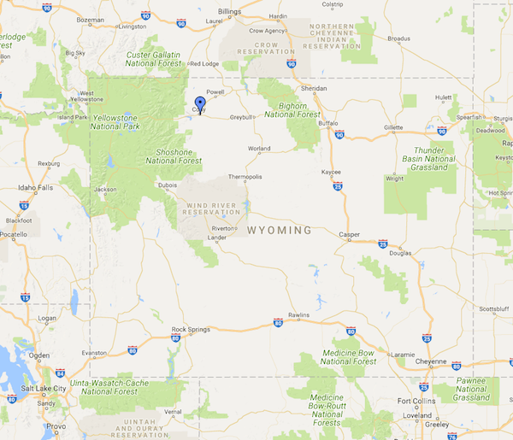
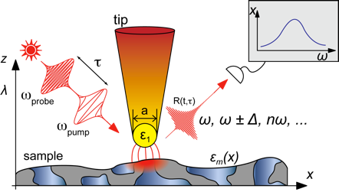

Autobiography
Born/raised up in Wyoming
Undergraduate at Michigan State University
Ph.D. at the University of Washington
  Thesis was on combining optical microscopy with atomic force microscopy to map the optical properties of materials with nanometer spatial resolution.
Spend ~4.5 years living in Kansas City working for an ultrafast laser company based in Vienna, Austria
Postdoc in Madison, WI in ultrafast spectroscopy
Present day: here at Los Alamos National Laboratory

Slide 3
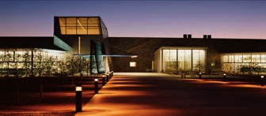
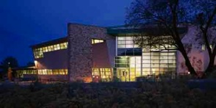
CINT is a LANL/SNL partnership to create a National resource for nanomaterials integration
Two NNSA Host Laboratories
Core Facility - SNL
CINT Today:
4 Science Thrusts, 1 leadership team
2 Facilities (total 130,000 gsf)
55 Scientists & Technologists
19 Affiliate Scientists
  Unique SNL/LANL capabilities & expertise
32+ Post-Docs & Students (SNL-LANL)
  800+ users engaged
  300+ projects accepted each year
  300+ publications annually
Peer-reviewed user proposal process
No-fee for pre-competitive research
Full cost recovery for proprietary research
Jeff Nelson, CINT Director
Gateway Facility - LANL
Adam Rondinone, CINT Co-Director

Slide 4
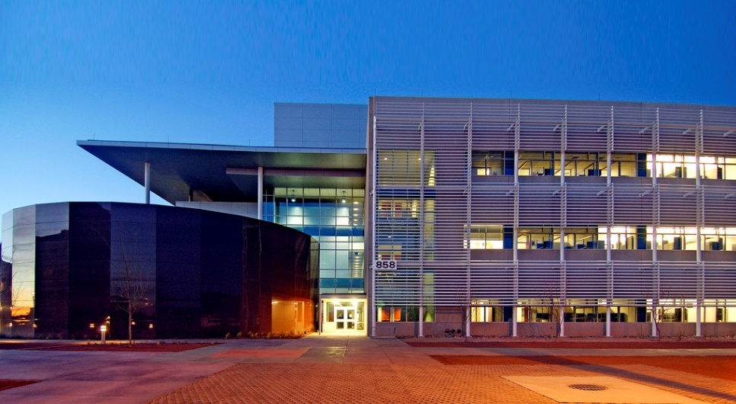
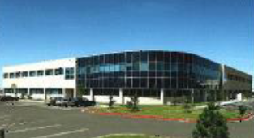
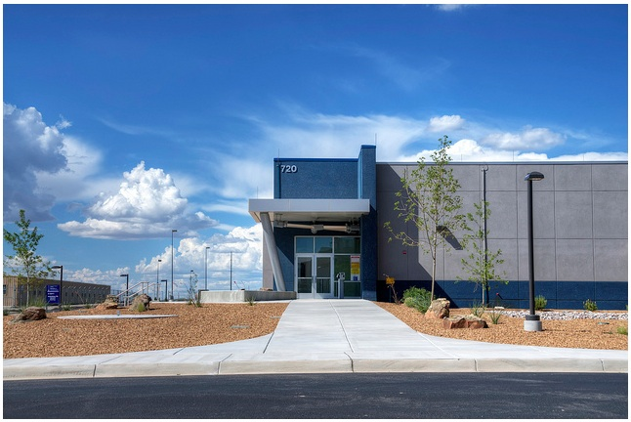
CINT users have access to unique host NNSA laboratory facilities
Microsystems and Engineering Science Applications (MESA)
Advanced Materials Laboratory (AML)
Integrated Materials Research Laboratory (IMRL)
Ion Beam Laboratory (IBL)
Sandia – California Lab
Ion Beam Materials Laboratory (IBML)
Notes:
LUMOS-The team at the Laboratory for Ultrafast Materials and Optical Science (LUMOS) seeks to understand and control the interaction of photons with materials’ electronic, spin, and structural behavior on the ultrafast time scale for missions of national security. Our research is focused on the properties and dynamic behavior of complex organic (polymers, molecules) and inorganic (multiferroics, heavy fermions and Kondo systems, topological insulators, and oxide heterostructures) materials.

Slide 5
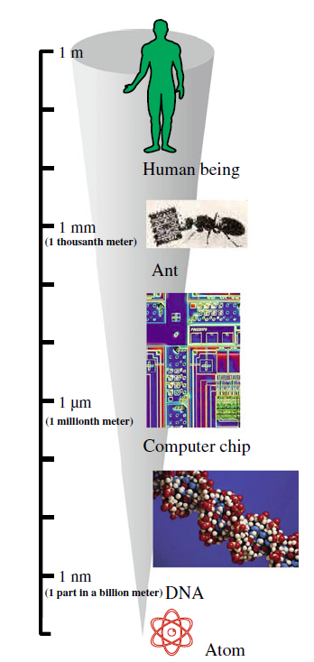
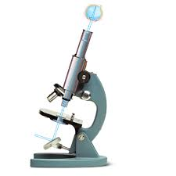
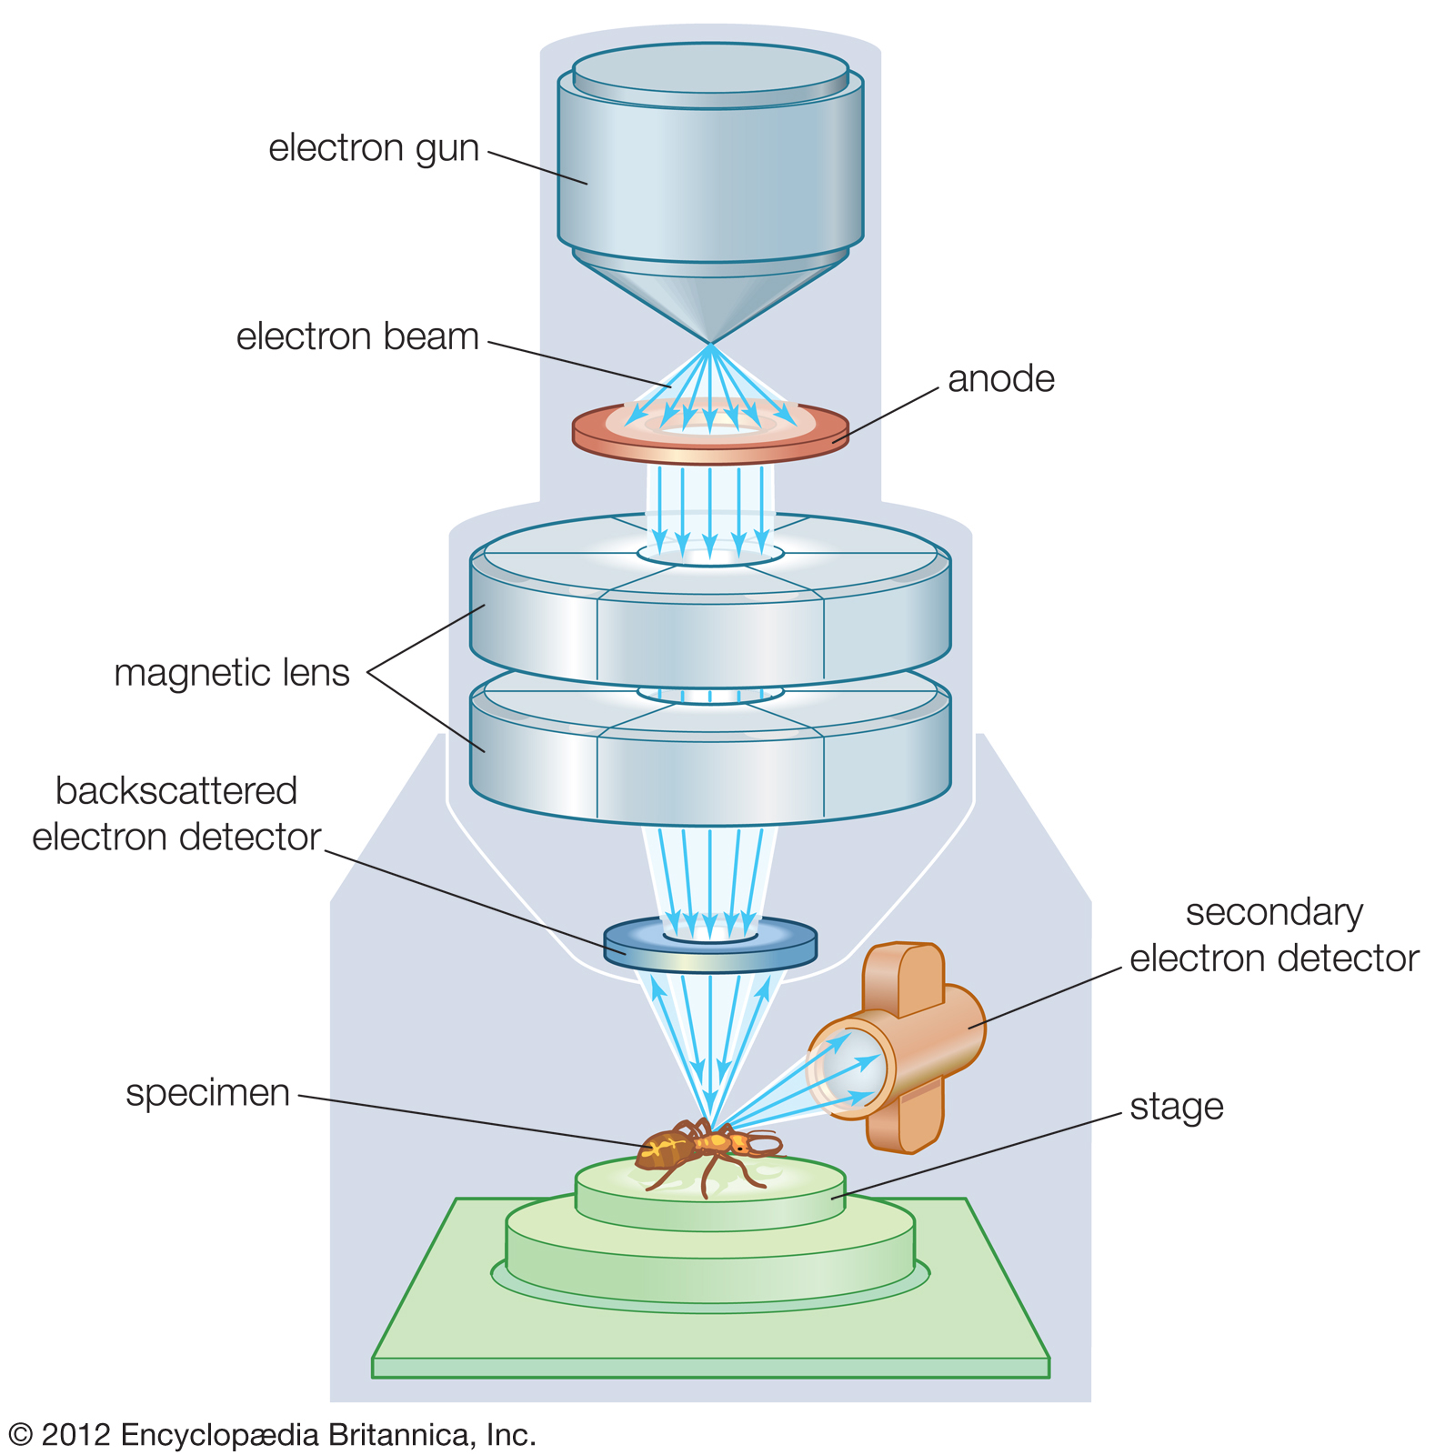

How do we study nanostructures?
Optical Microscopy
  Pro: Relatively easy to implement
  Con: Limited in resolution by the diffraction limit
Electron Microscopy
  Pro: Very high resolution
  Con: Expensive, requires vacuum, conductive samples
Scanning Probe Microscopy
  Pro: High resolution
  Con: Dependent on sharp probes, signals harder to model

Slide 6
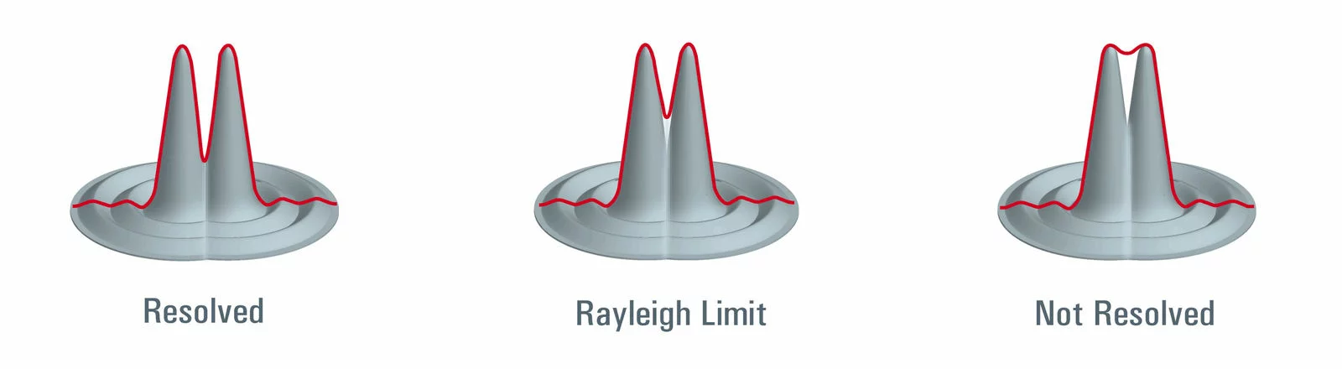
The Diffraction Limit for Optical Microscopy
An Airy Disc is the optimally focused point of light which can be determined by a circular aperture in a perfectly aligned system limited by diffraction.
d= λ/2 NA
  d: diameter of inner circle/resolution limit
  λ: Wavelength of light
  NA: Numeric aperture
    Related to the solid angle of light a microscope objective collects
    Typical values range from ~0.2-1.0

Slide 7

Why is this a problem?
Sub-Diffraction limit nanostructures
  Traditional optical microscopy unable to resolve spatial features below several hundred nanometers
Heterogeneous Materials
  The response of multiple mixed materials can’t be separated from one another.
Other Interactions:
  Optical Microscopy can’t necessarily provide information on the electronic, magnetic, piezoelectric, and mechanical properties of materials.
λ =600 nm
d ~300-1200 nm

Slide 8
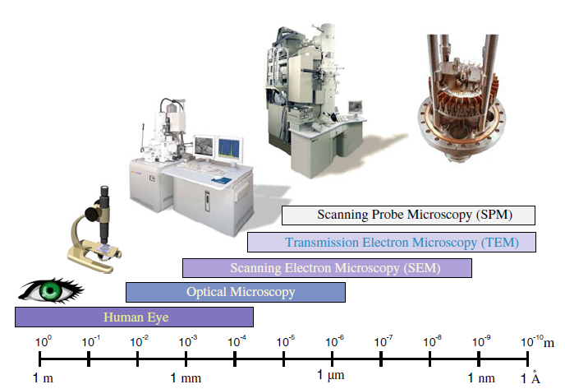
Breaking the diffraction limit with non-optical microscopy

Slide 9
A comparison of nanoimaging techniques
 | AFM | STM | SEM | TEM
Sample preparation | Little to none | From a little to a lot | From a little to a lot | From a little to a lot
Resolution | 0.1-10 nm | 0.1 nm | 5 nm | 0.1 nm
Relative cost | Low | Low to medium | Medium | High
Sample environment | Any | Typically vacuum | Typically Vacuum | Vacuum
Depth of field | Poor | Poor | Good | Poor
Sample type | Any | Conductive | Conductive | Any
Time for image | 2-5 min | 2-5 min | 0.1-1 min | 0.1-1 min
Maximum field of view | 100 um | 100 um | 1mm | 100 nm
Maximum sample size | Unlimited | 30 mm | 30 mm | 2 mm
Measurements | 3 dimensional | 3 dimensional | 2 dimensional | 2 dimensional

Slide 10
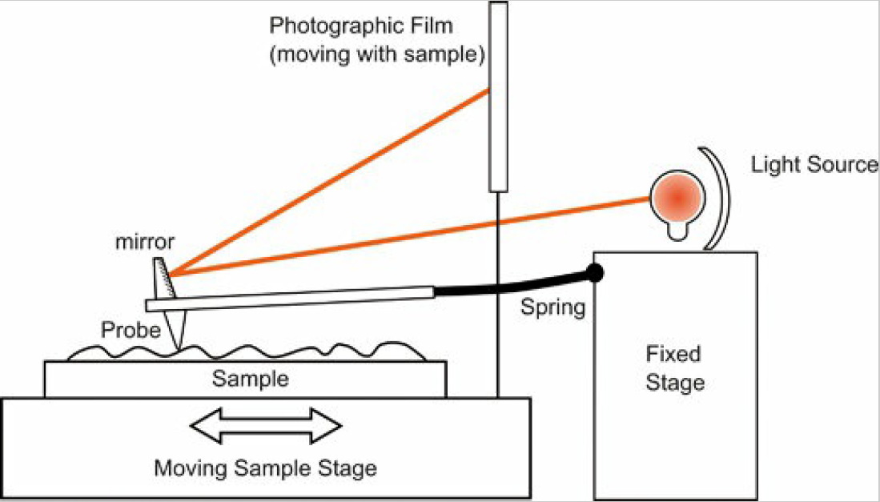
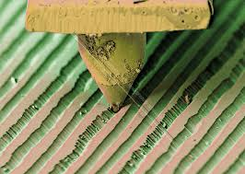
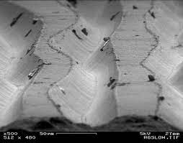
Early Scanning Probes
Scanning Stylus Profilometer. Gustev Schmaltz, 1929
Scanning Stylus Profilometer
  Up and down motion of sharp probe in contact with a surface is monitored by observing flexure of cantilever through observation of light reflected onto a photographic plate.
  1000x magnification achieved
  Same Concept as record player- instead of transducing grooves to sound, they are imaged on a photograph
Atomic Force Microscopy. Peter Eaton and Paul West. 2010
SEM images of grooves in a Vinyl record

Slide 11
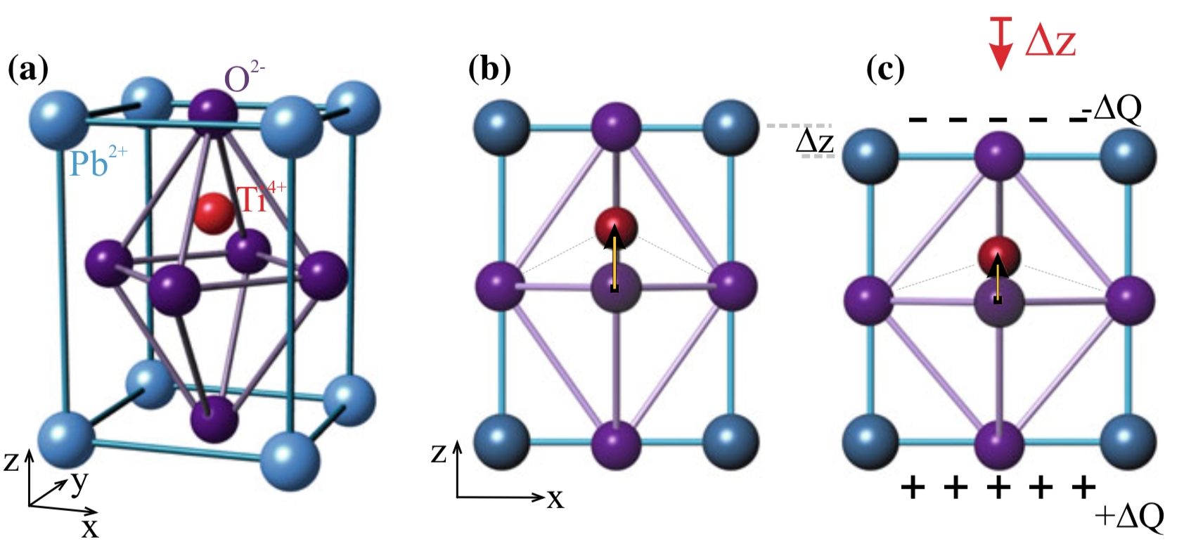
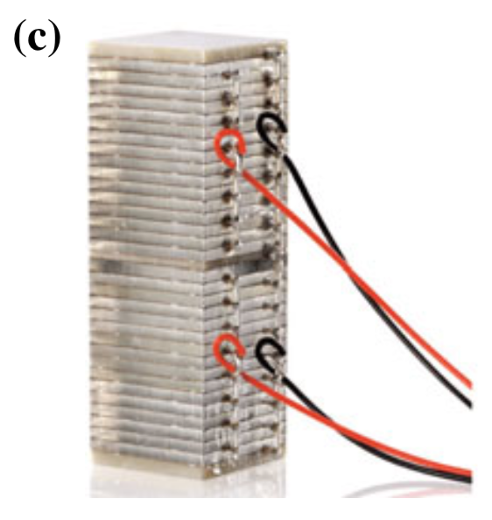
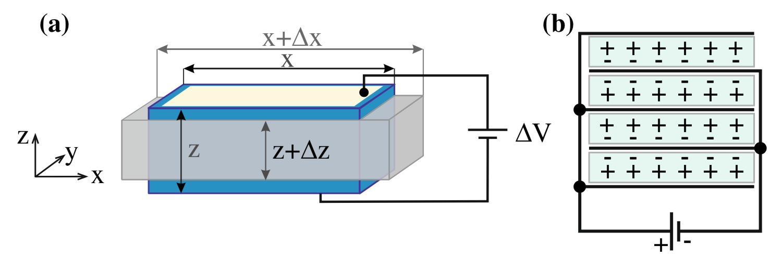
Enabling nanoscale motion: piezoelectronics
Piezoelectric Effect:
  Application of a voltage to induce an electric field within a piezoelectric material (as in a capacitor with a dielectric) resulting in an extension or contraction of the piezo material
  occurs only for crystals which are not centrosymmetric, i.e. do not have an inversion center
PZT: lead zirconate titanate Pb[ZrxTi₁−x]O₃
Piezo plate
Stacked Piezos

Slide 12
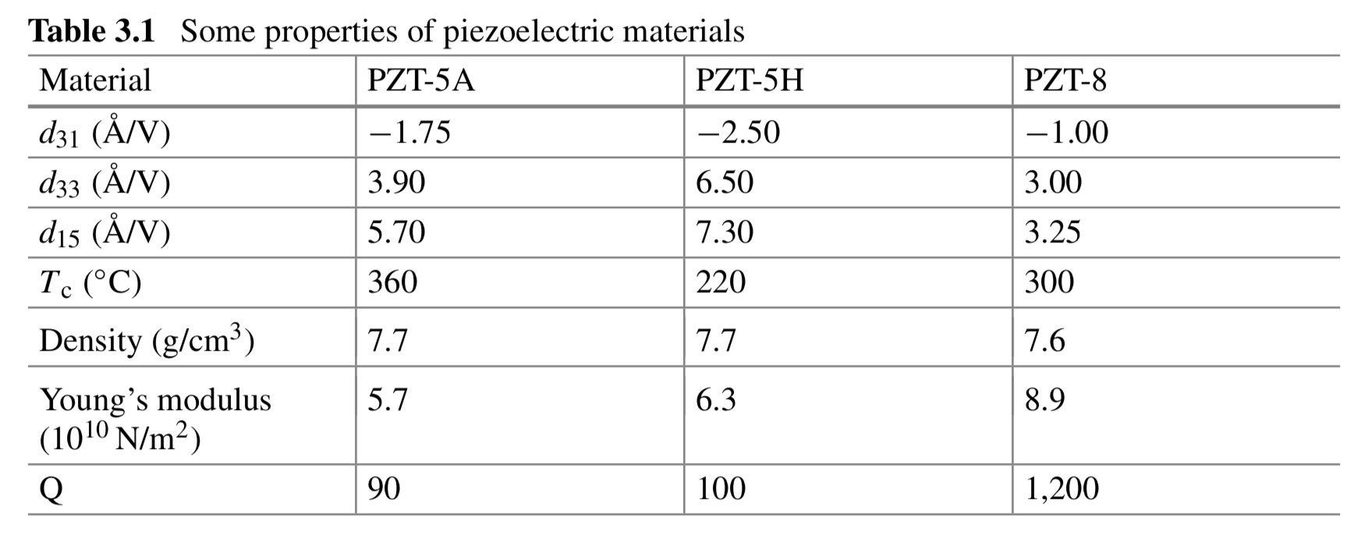


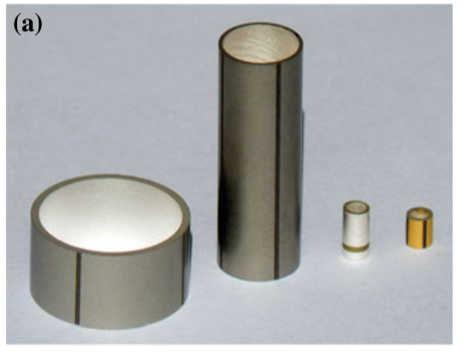
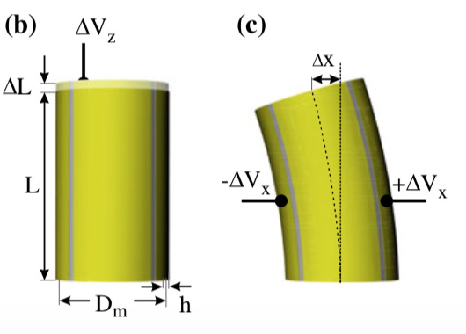
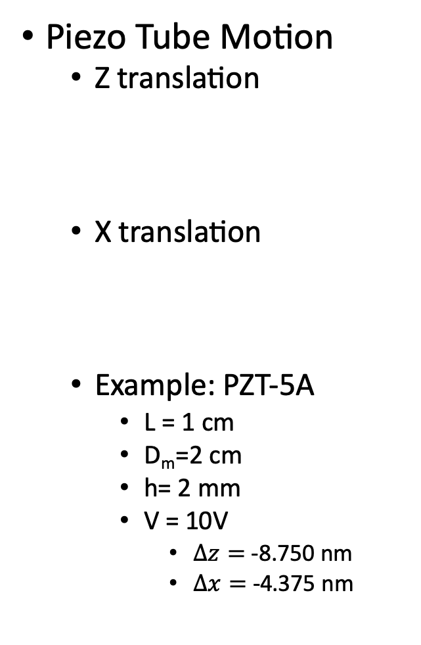
Scanning with nanometer resolution today
Piezo Tube Motion
  Z translation
  X translation
  Example: PZT-5A
    L = 1 cm
    D_{m}=2 cm
    h= 2 mm
    V = 10V
      $∆z=$-8.750 nm
      $∆x=$-4.375 nm
500: 14k
510: 15;
520: 12686
530: 20k
650: 7300

Slide 13
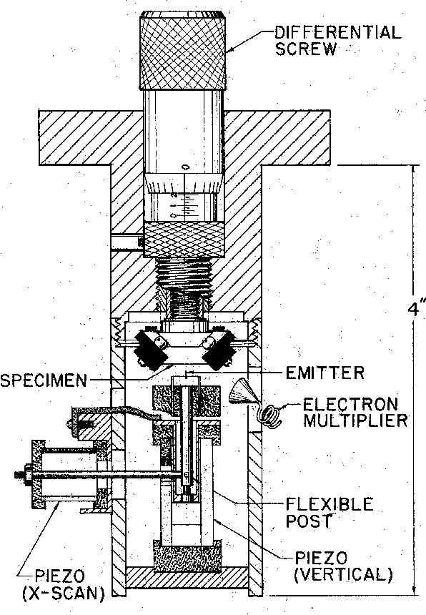
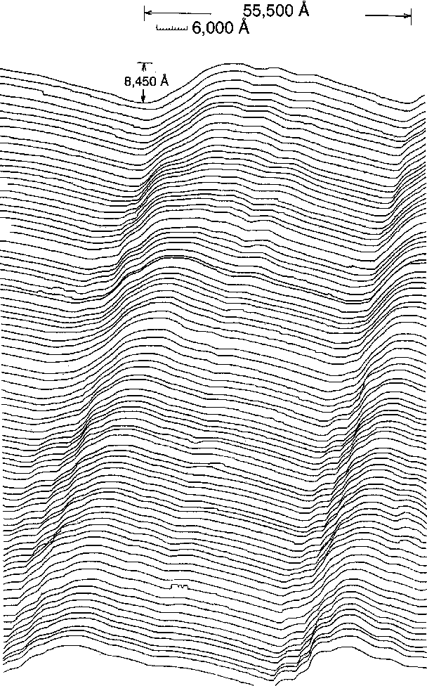
The Topografiner
Utilized Piezoelectric scanners to achieve high spatial resolution scanning.
Close tip-sample distance was maintained using the enhancement of field electron emission from a sharp metallic probe near a metallic surface.
R. Young, J. Ward, and F. Scire,
The Topografiner: An Instrument for Measuring Surface Microtopography,
Rev. Sci.Instrum. 43, 999-1011 (1972).

Slide 14
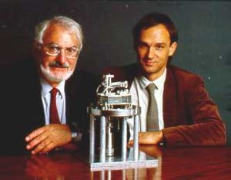
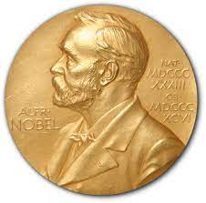
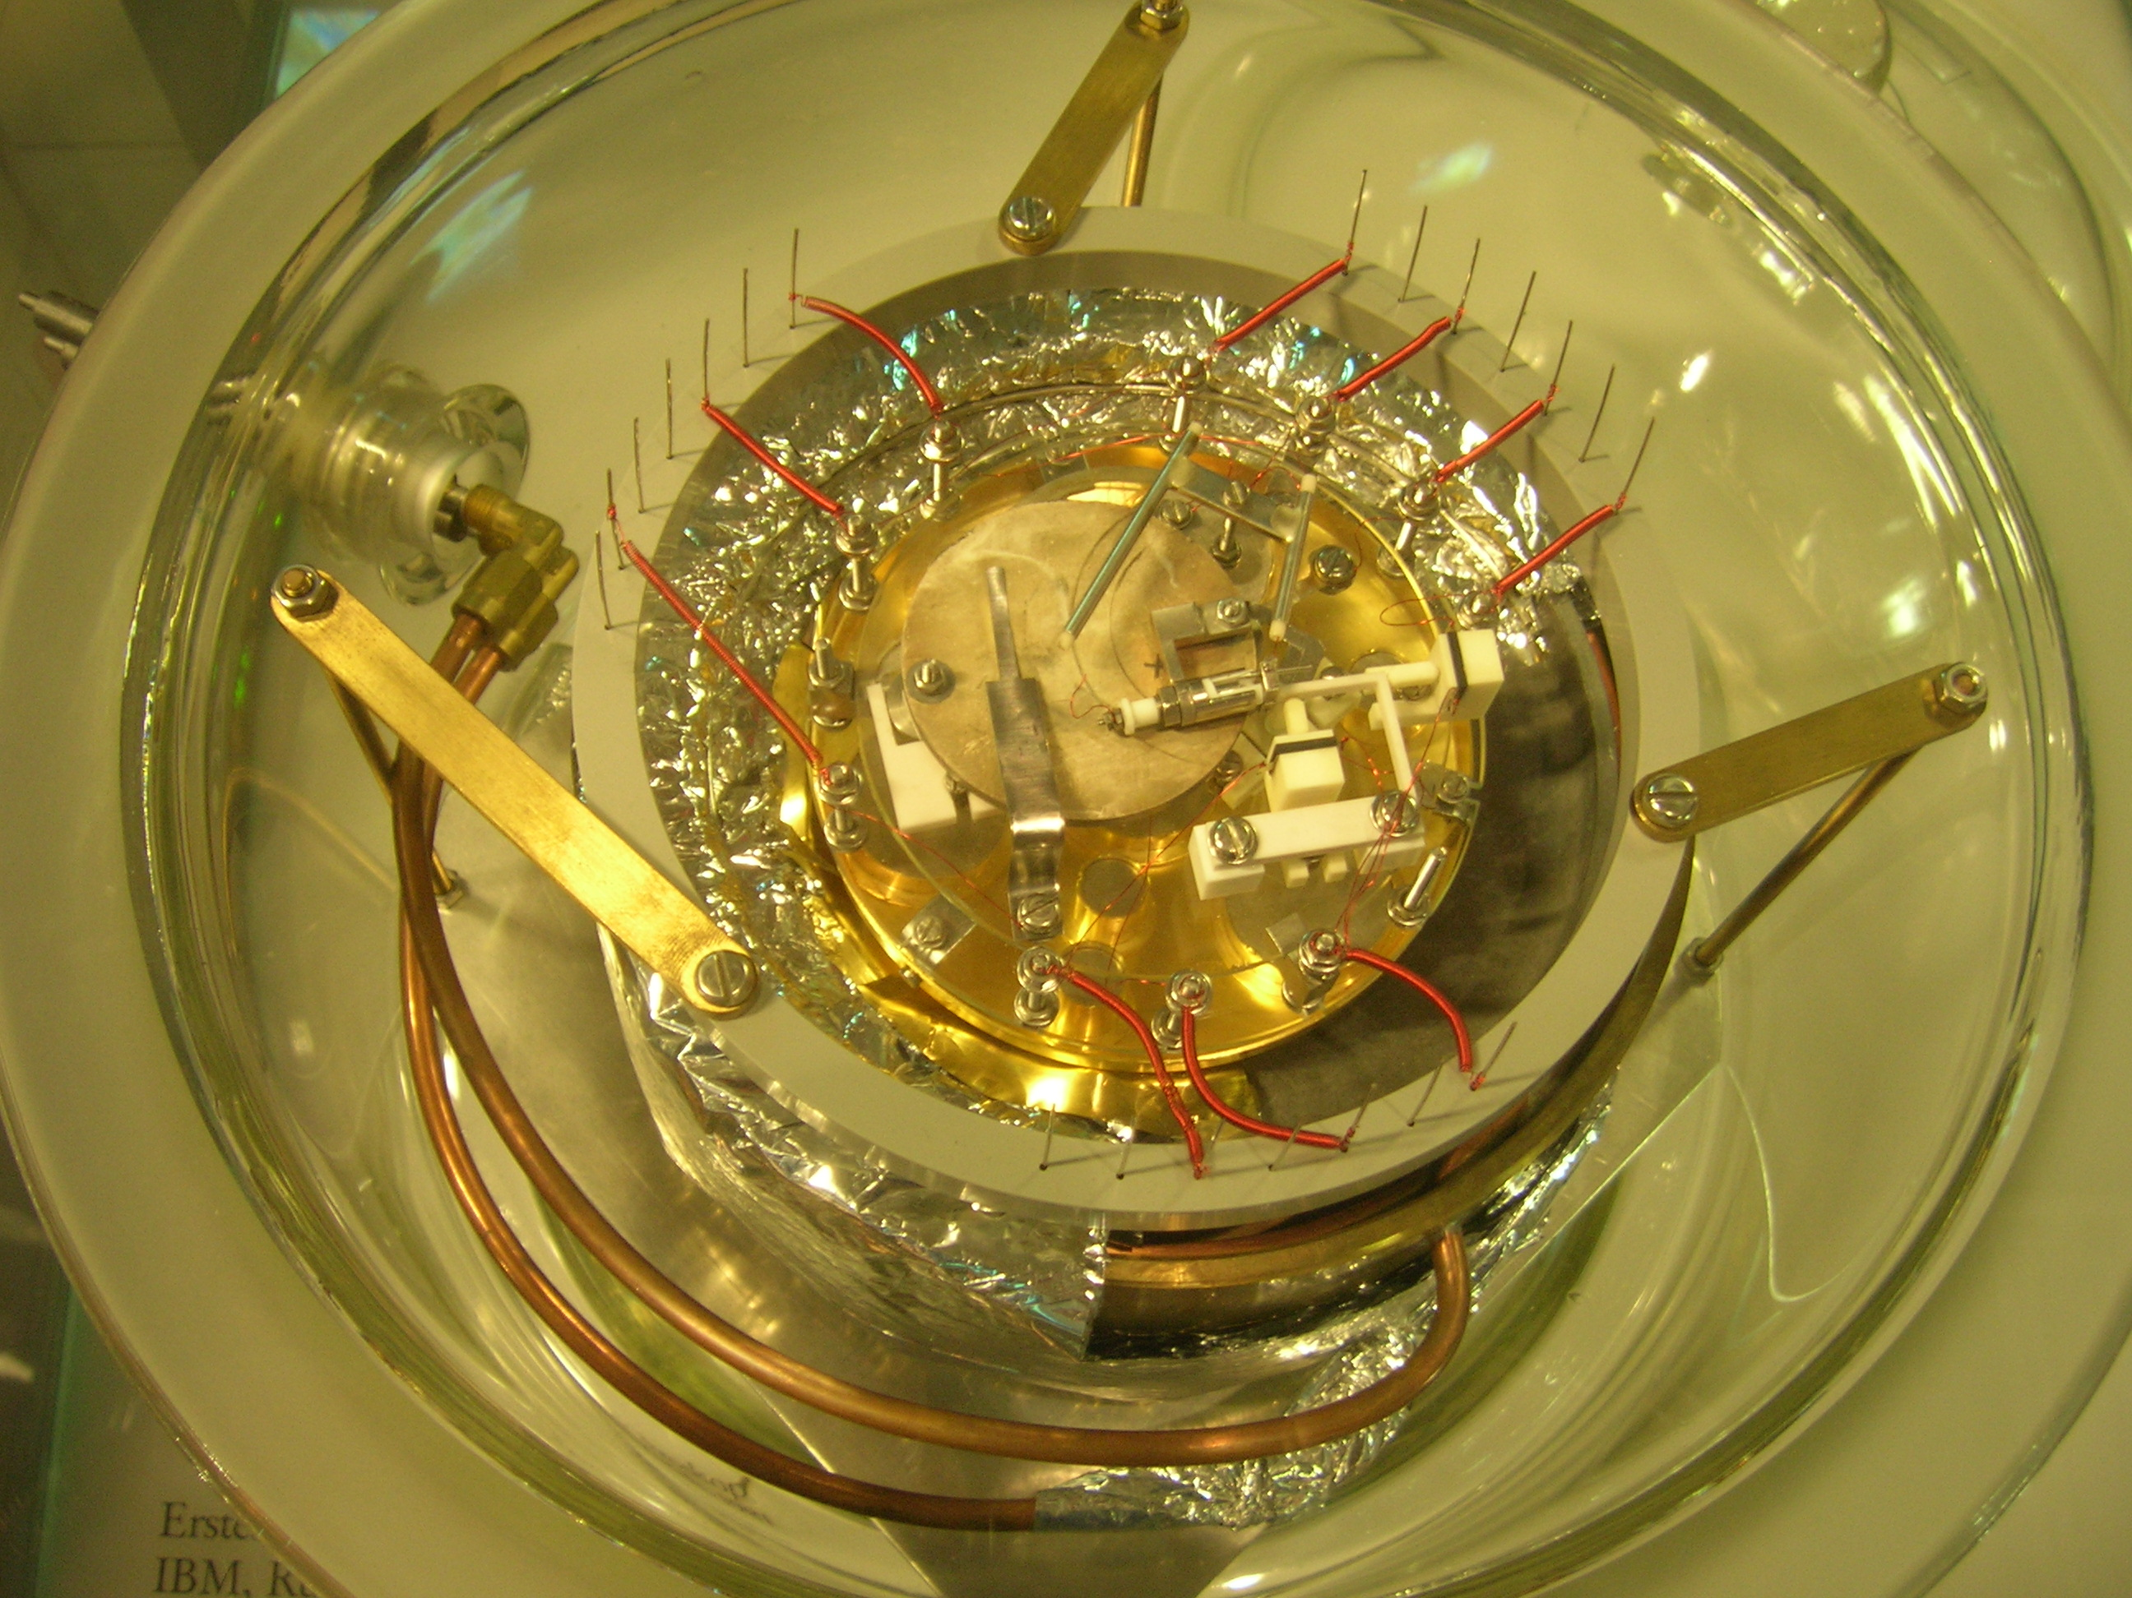
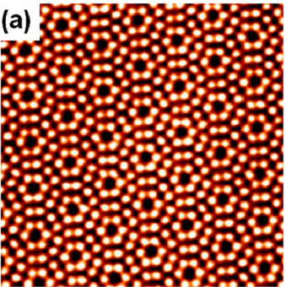
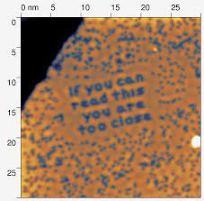
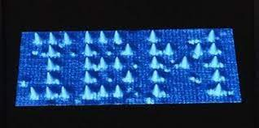
Development of STM
1981 first demonstration in by Binnig et al.
1982 First image of the atomic structure of the Si(111)-(7×7) surface by Binnig et al.
1986 Nobel prize in physics for the invention of the STM awarded to Binnig and Rohrer
1990 First positioning of single atoms on a surface with a low temperature STM by Eigler and Schweizer
1986 Nobel Prize: Gerd Binnig and Heinrich Rohrer
"for their design of the scanning tunneling microscope."
First STM
Atomic Resolution:
Si (111) surface

Slide 15
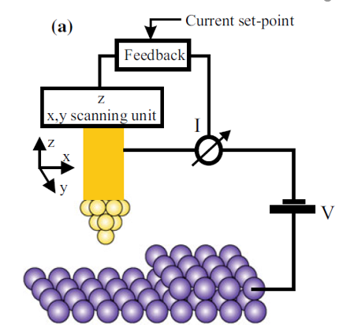
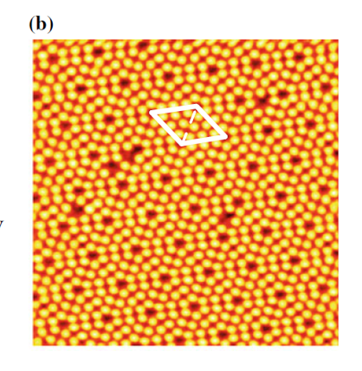
Scanning Tunneling Microscopy
Instrument "feels" them by scanning the surface line by line with a very sharp tip at a constant distance of a few atomic diameters.
This distance is minimized in a feedback loop by the tunneling current through the tip and sample when a voltage is applied.
The current is extremely dependent on the distance between tip and sample
  the smaller the distance, the larger the current.
  Reducing the distance by only one-tenth of a nanometer can increase the current tenfold.

Slide 16
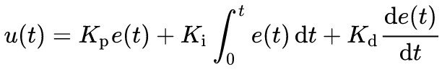
Maintaining Close Tip-Sample Separation:
PID Feedback Control
P, K_{p}: Proportional Feedback
I, K_{I}: Integral Feedback
D, K_{d}: Derivative Feedback
e: error signal- difference between a desired setpoint and an experimental value
  For scanning tunneling microscopy, this would be the tunneling current
u: control variable
  For the case of scanning probe instruments this is the z direction piezo voltage

Slide 17
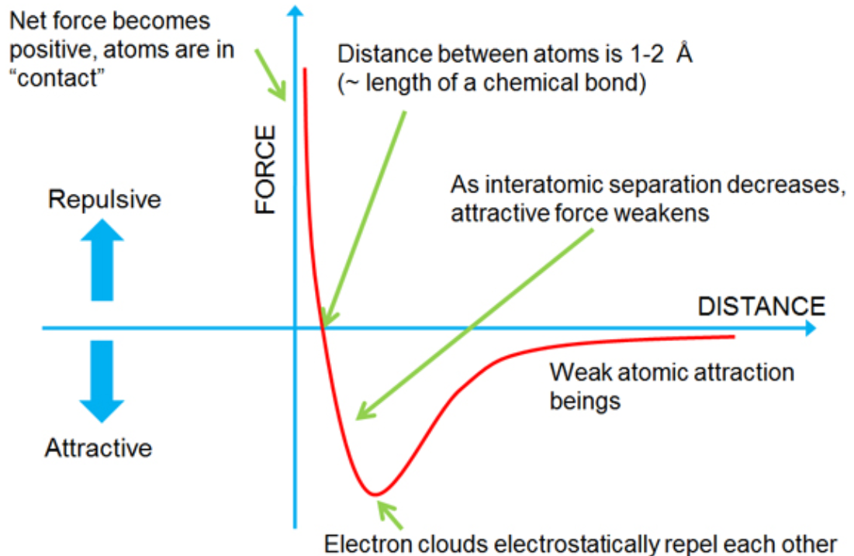
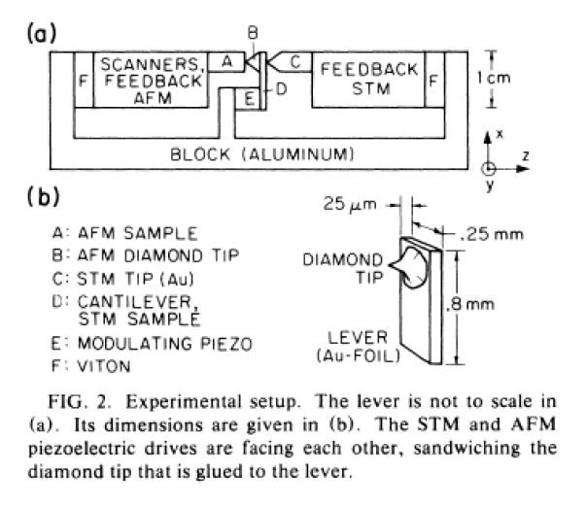
Scanning Insulating Surfaces: Atomic Force Microscopy
Rather than use current as feedback, utilizes the deflection of a cantilever.
First demonstrated in 1985 by Binnig et al.
First Atomic Force Microscope

Slide 18
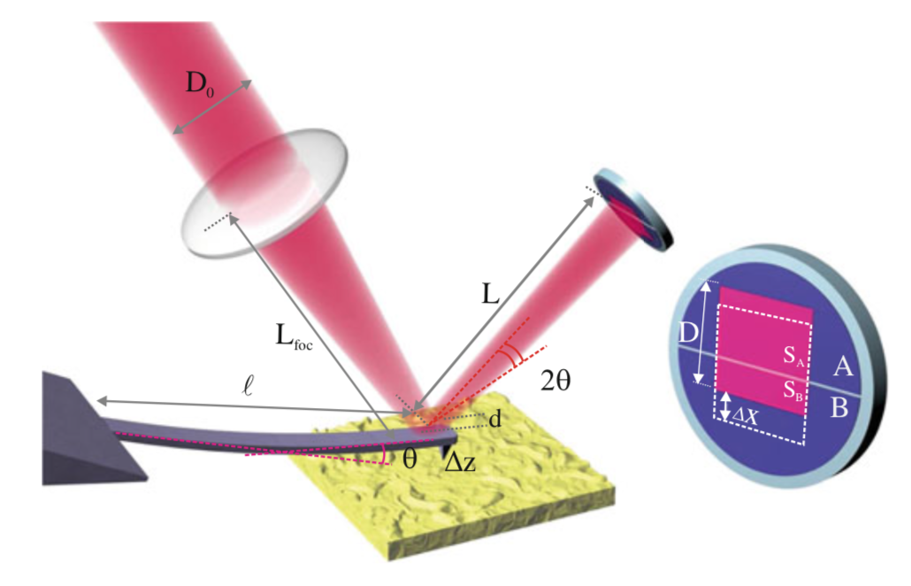
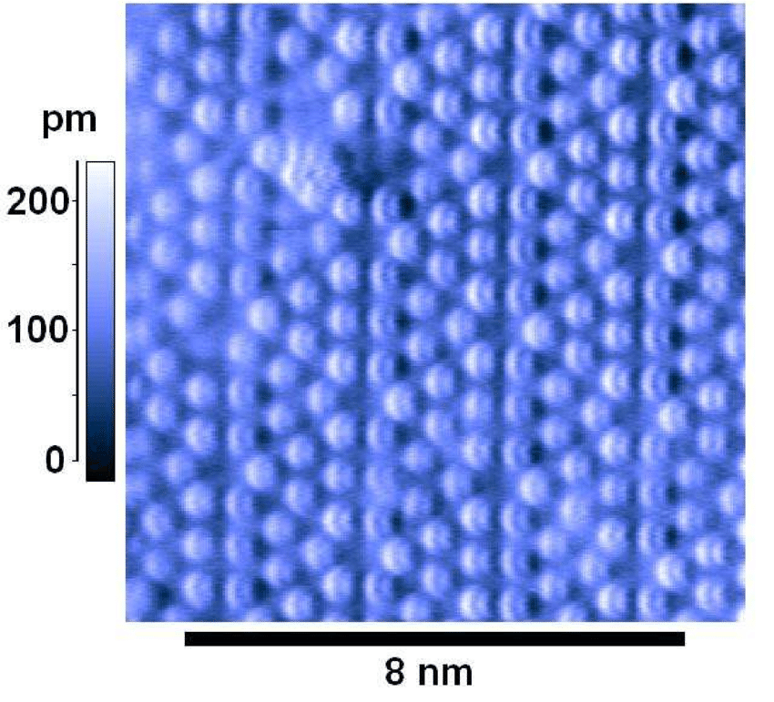
Continued Development of AFM
Optical Detection of beam deflection
1990 Optical beam deflection method introduced by Meyer and Amer
1993 Tapping mode in AFM introduced by Zhong et al.
1995 First atomic resolution with an AFM by Giessibl et al
First imaging of Si (111) using AFM

Slide 19
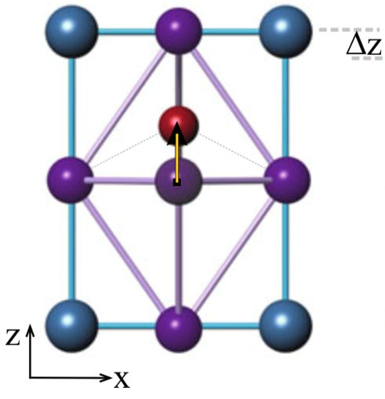
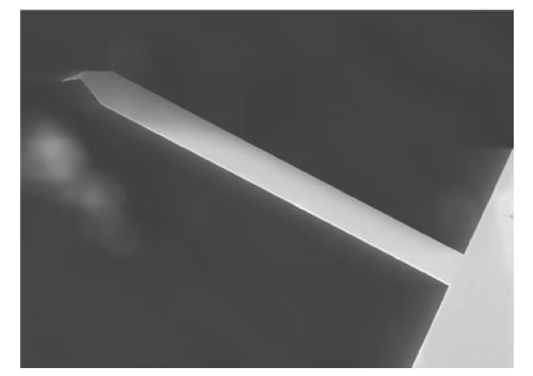
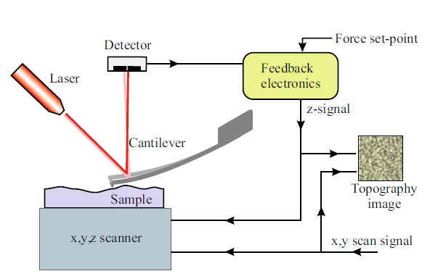
Ingredients of Modern Atomic Force Microscopy
Precision control over Motion (Piezoelectric Scanners)
Vibrational Isolation
Ultrasharp, nanometer scale probes
Precise Detection of Probe Deflection
Feedback loop to maintain tip-sample separation

Slide 20
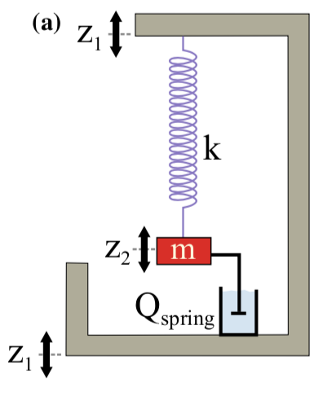
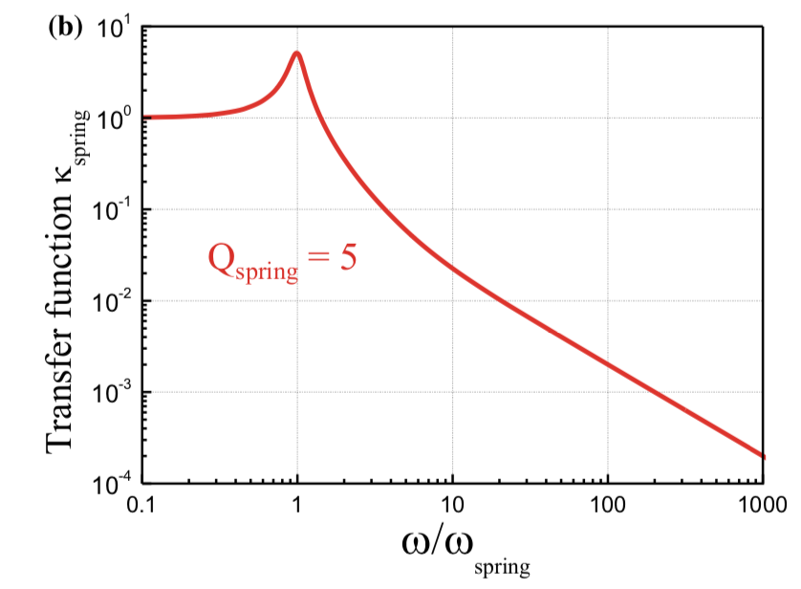
Vibration Isolation
Building Vibrations ~100 nm
For a target accuracy ~ 0.1Å =0.01 nm necessary for atomic precision, a factor of 10 lower vibrational noise would roughly be required: ~ 1 pm
Factor of 10⁻⁵ reduction in vibrational noise is necessary to obtain a sufficiently stable tip-sample distance

Slide 21
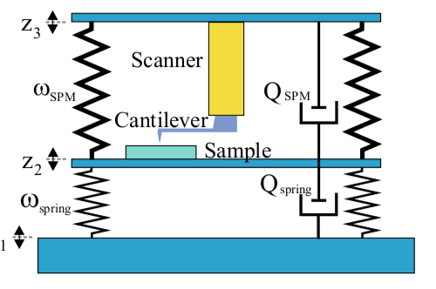
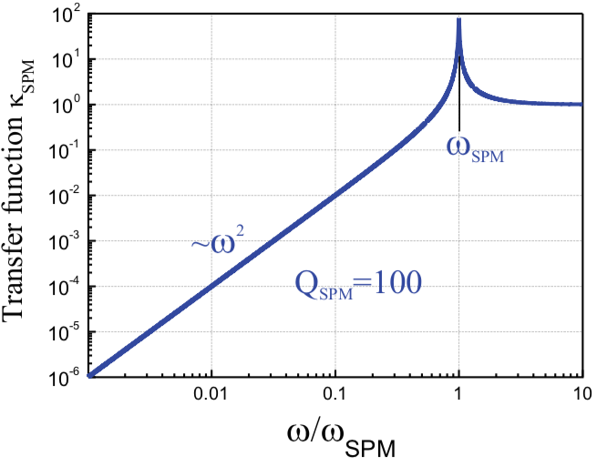
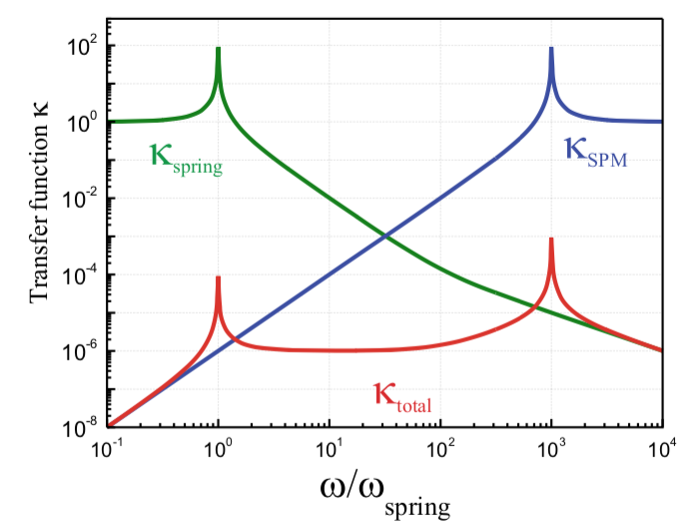
Anti-Resonant Vibration Isolation
Matching anti-resonant spring vibrational transfer functions allows us to reach the required 10⁻⁵ reduction necessary for achieving atomic resolution scanning

Slide 22
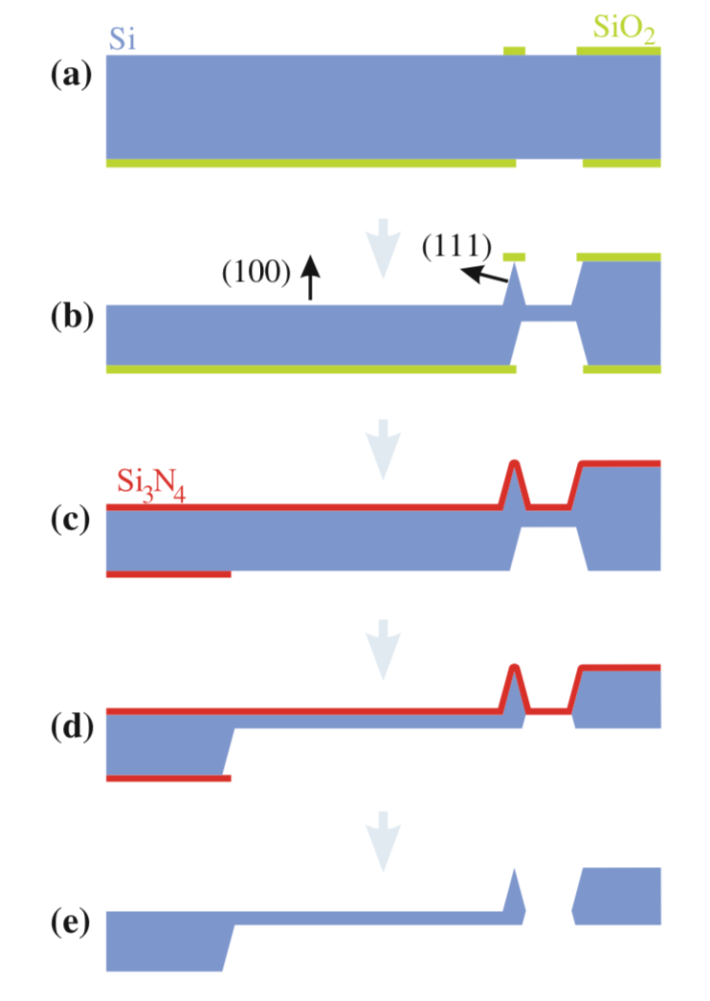
Creating a Sharp Probe using etching
produced by semiconductor microfabrication processes using silicon or silicon nitride.
a) a structured SiO₂ layer is formed on a Si(100)-oriented wafer
b) wet etching leads to a preferred etching in the (100) direction in areas where no SiO₂ layer is present. SiO₂ pad falls off and etching is complete
c) the top of the wafer and on the bottom the handle part (cantilever base) are covered by Si₃ N₄ to protect the tip structure
d) wet etching thins the back of the cantilever
e) Final wet etching of Si₃ N₄ removes cantilever

Slide 23
What do AFM probes look like in practice?
Scout-150
Nu Nano
Cantilever and Self-Sensing probes
Tip Shape
  Conical
  Pyramidal
  Needle
  Forward Pointing
Coatings:
  Insulating: Silicon Nitride
  Conductive: Gold, PtIr, Diamond, Tungsten
  Magnetic: Cobalt
Tip Radius: 2-100 nm, Typically 10-20 nm
Resonance Frequency: 20-500 kHz
Spring Constant, k: 0.1-100 N/m
  Softer: good for Force Sensing
  Stiffer: Nanoindentation
Bruker SCM-PIT
Tuning fork AFM probe
Bruker PF-TUNA
NanoSensors ATEC

Slide 24
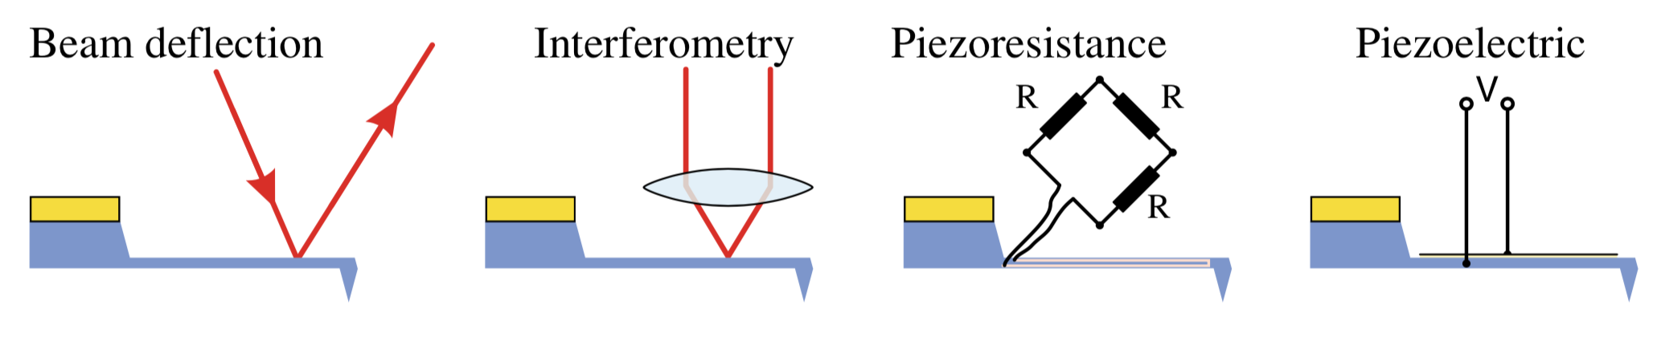
Sensing Deflection of a Cantilever
There are a number of methods for sensing cantilever deflection
Laser beam deflection is the most common for ambient temperature AFM
Interferometry and Piezoresponse methods more commonplace for systems in systems
Detection of beam deflection
using a quadrant photodiode

Slide 25
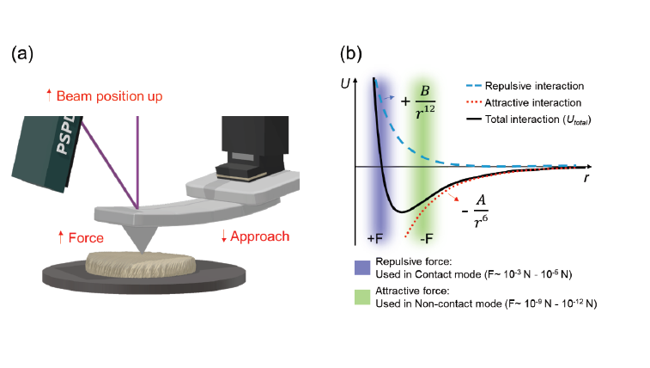
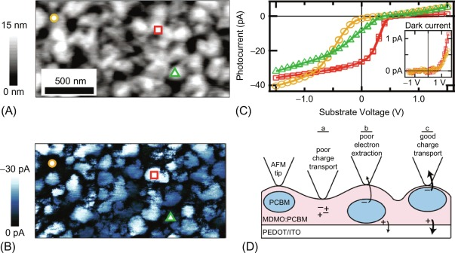
Contact Mode Atomic Force Microscopy
Monitor the static deflection of an AFM cantilever
  Long cantilevers with low spring constants are employed to reduce contact forces
  Typical Contact Force ~ 1-100 nN
Advantages:
  Useful for conductance measurements
  Precise height measurements
Disadvantages:
  Probe degrades quickly
    Dulling
    Particulate sticking to probe
  Susceptible to vibrational/electronic noise
Contact Mode and Current Mapping of Organic Photovoltaic Device
Coffey, D.C. et al. Nano Lett. 7(3) (2007) 738–744.

Slide 26
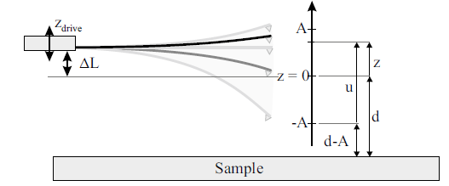


Tapping Mode AFM
AFM Cantilever is sinusoidally driven to oscillate up and down
Amplitude of Phase of oscillations is used to maintain a close tip-sample separation distance
Well described by the Damped Driven Harmonic Oscillator problem

Slide 27





Modeling an AFM cantilever as a spring
Consider a cantilever as a spring with mass
Velocity of cantilever element is determined by its position:
  Corresponding Kinetic Energy
Integrating over length of the cantilever:
a mass-containing spring is equivalent to a massless spring with
an effective mass m_{eff} = 1/3m_{spring}
Total effective mass becomes: m_{eff} = M+1/3m_{spring}

Slide 28









Modeling AFM: Damped driven Harmonic Oscillator
Hooke’s Law for Spring Motion:
Newton’s 2nd law for the equation of motion:
General form of solutions
  Usually re-expressed as:
$ω_{0}$: resonance angular frequency
  $f_{0}:$ Resonance Frequency [Hz]

Slide 29




Adding Piezo Driving
drive
Mass driven by moving the base of the spring
  Note: ω_{drive} can be different from the natural frequency of the oscillator ω₀
Updated Equation of Motion:
Guess Solution:
By inserting into Eq. of Motion and solving:
drive

Slide 30








Adding Damping
Damping can occur through air drag or other sources and is described as proportional to the speed of the mass.
  $γ$: damping coefficient
Updated Eq. of Motion:
  Using
Solutions take form (skipping some Algebra):
  Assumes phase of drive = 0,
drive
drive

Slide 31





Quality Factor
Amplitude and phase are often defined in terms of a dimensionless Quality factor related to the resonance frequency and the damping:

Slide 32

How Surface Forces Affect our Resonance
A Force gradient results in a shift in the resonance frequency

Slide 33

How Surface Forces Affect our Resonance 2
Increased surface dissipation results in increased damping
  Amplitude and phase shifts can be identical to those induced by force

Slide 34

Extracting Force Information: Lift Mode
Retracing a scan in above surface
Surface dissipation cannot affect signals
Long Range forces can be measured by the amplitude and phase of cantilever motion
Examples of long range forces:
  Electrostatic Interactions
    Electrostatic Force Microscopy (EFM)
  Magnetic Interactions
    Magnetic Force Microscopy (MFM)

Slide 35

Conceptual Design of an Atomic Force Microscope
Base: Isolates Vibrations
Flexure Stage: Provides nanometer scanning control
Cantilever: nanometer scale probe to interact with surface
Optical Stage: Provides Detection of the Cantilever Detection

Slide 36




Mapping Topography using AFM
Most basic function of AFM
Provides 3D information on the morphology of a sample surface.
Resolution Limit:
  Defined by sharpness of AFM probe.
  Can be down to atomic limit for functionalized AFM interactions, but typically 2-20 nm.
AFM of Graphene flake
AFM of DNA Plasmids
AFM of carbon nanotubes
AFM of quantum dots

Slide 37
Characterizing forces above a surface
Using lift mode- we can search for the presence of long range force gradients above a surface associated with electromagnetic forces

Slide 38


Magnetic Force Microscopy
AFM cantilever coated with a Magnetic thin film (typically Cobalt) is scanned in lift mode over a surface
Magnetic attraction results in a phase shift in the cantilever oscillation mapping regions with attractive and repulsive forces.
Identifies nanomagnetic domains and particles.
topography
MFM phase

Slide 39


Electrostatic Force Microscopy
Metallic AFM cantilever scanned in lift mode over a surface
Electrostatic Forces due to potential differences between the probe and the surfaces are mapped via phase shift
Identifies areas with electrostatic potential variation on surface
Mapping the location of singe and few layer epitaxial graphene grown on SiC by monitoring phase shift in EFM signal.
Burnett, T. et al. Nano Let. 8,11 (6). 2324, (2011)

Slide 40

Photo-Induced Force Microscopy
Using laser illumination of the tip-sample gap region, an attractive force is induced between the AFM probe and the surface.
Mapping the magnitude of this attraction reveals where our sample responds to the wavelength of illumination
Often used with Mid-IR excitation for nanoscale mapping of chemical variation
Science Advances 25 Mar 2016: Vol. 2, no. 3, e1501571

Slide 41

Near-field Optical Spectroscopy
Relies on enhancement of optical fields between a sharp AFM probe and a sample surface
Multiple detection Mechanisms
  Elastic scattering
    Scattering Scanning Near-field Optical Spectroscopy (s-SNOM)
  Tip Enhanced Raman Spectroscopy (TERS)
  Tip Enhanced Photoluminescence (TEPL)
  Tip Enhanced Second Harmonic Generation
Optically Detected Elastic Scattering by Plasmonic Ag nanoparticle
Nano Lett., Vol. 8, No. 10, 2008

Slide 42



Nanomechanical Mapping
By performing approach curves we can extract information on the mechanical properties of a surface: Youngs modulus, Adhesion, etc..
Height image of a PS+LDPE blend sample with respective adhesion and modulus maps.
https://bbml.sitehost.iu.edu/afmintro.html

Slide 43

Overview
Scanning probe microscopy represents a tool which we can leverage to extract valuable information on surface properties
  Magnetic
  Electric
  Piezoelectric
  Optical
  Mechanical
These techniques represent one, of many, pathways which we can utilize to better understand how to understand the unique properties of the nanoscale.

Slide 44

Questions/Assignment:
Given your area of expertise, pick any of the techniques presented today that might be applied to help study a material in which you have interest. Find and read a research paper applying this technique. Answer the following questions:
1) Which scanning probe technique was applied? Why was it chosen?
2) What material properties were the researchers trying to extract?
3) For AFM, did they use tapping, contact, or another form of feedback- and why?
4) What other scanning probe methods might also be applied to study this system?

