Slide 1
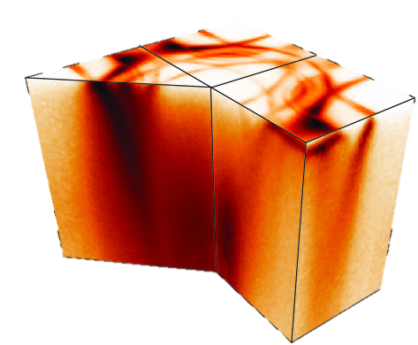
Seeing Electrons: A Pedagogical Introduction
To Angle-Resolved Photoemission Spectroscopy
Phil Murgatroyd
MPA-Q, LANL
Los Alamos Computational Condensed Matter Summer School 2026
6/22/2026

Slide 2
Section 1: Emergent Phenomena
Notes:
It tells us:
Energy
Momentum
Lifetime
Spectral weight
If we could measure $A\left(k , ω\right)$, we could directly observe many-body physics.

Slide 3
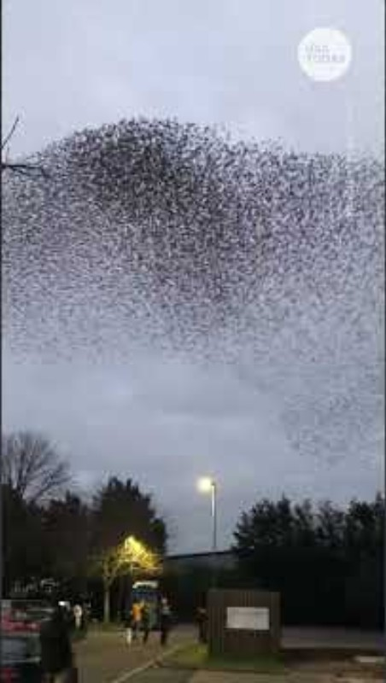
Simple local interactions can give rise to extraordinary collective behavior
Notes:
If I asked you to understand this system by tracking the trajectory of a single bird, you'd miss the point entirely. The remarkable behaviour emerges from the interactions between many individuals.
Condensed matter physics faces a similar challenge...

Slide 4
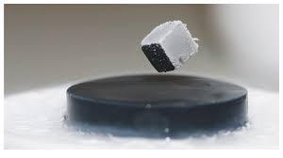
Collective electronic behavior gives rise to emergent quantum phenomena
Superconductivity
Notes:
Levitation → correlations create macroscopic order (superconductivity)
Wigner crystal → correlations localize and organize electrons (Mott/Wigner physics)
Cold atom TOF → correlations drive phase transitions (emergence of new states)

Slide 5
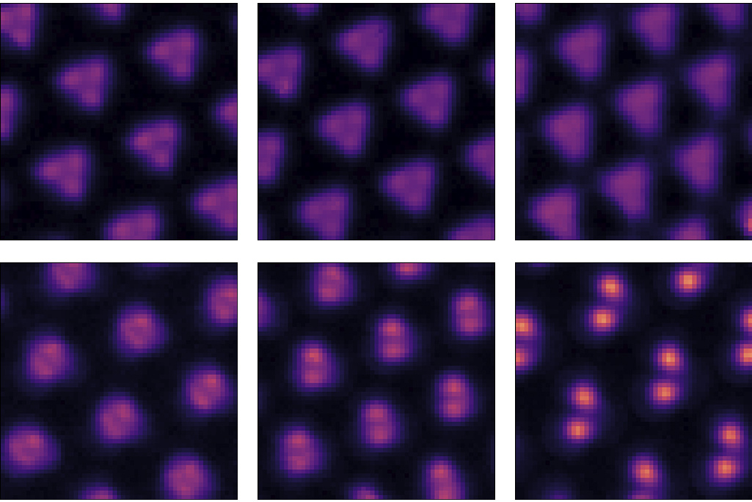
Collective electronic behavior gives rise to emergent quantum phenomena
Superconductivity
Wigner Crystal
Notes:
Levitation → correlations create macroscopic order (superconductivity)
Wigner crystal → correlations localize and organize electrons (Mott/Wigner physics)
Cold atom TOF → correlations drive phase transitions (emergence of new states)

Slide 6
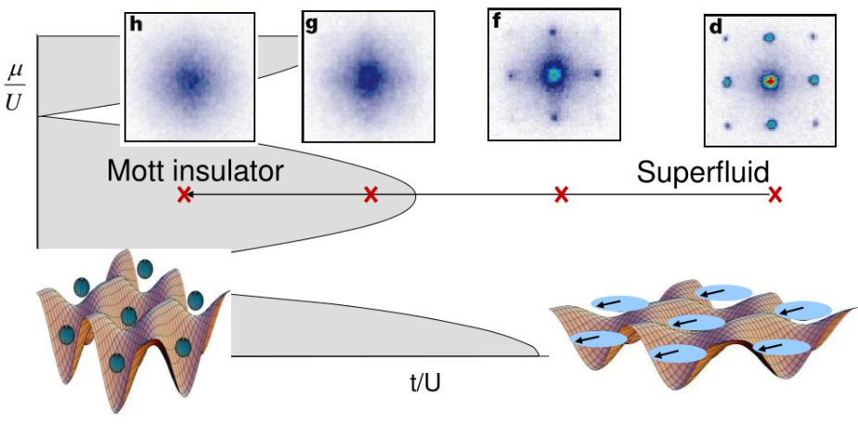
Collective electronic behavior gives rise to emergent quantum phenomena
Superconductivity
Wigner Crystal
Mott insulator — superfluid
transition in cold atoms
Notes:
Levitation → correlations create macroscopic order (superconductivity)
Wigner crystal → correlations localize and organize electrons (Mott/Wigner physics)
Cold atom TOF → correlations drive phase transitions (emergence of new states)

Slide 7
Collective electronic behavior gives rise to emergent quantum phenomena
Superconductivity
Wigner Crystal
Mott insulator — superfluid
transition in cold atoms
How do we connect these macroscopic phenomena to their microscopic origin?
Notes:
Levitation → correlations create macroscopic order (superconductivity)
Wigner crystal → correlations localize and organize electrons (Mott/Wigner physics)
Cold atom TOF → correlations drive phase transitions (emergence of new states)

Slide 8
How do we probe quantum matter?
Macroscopic Probes

Slide 9
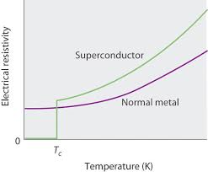
How do we probe quantum matter?
Macroscopic Probes
Electrical Transport

Slide 10
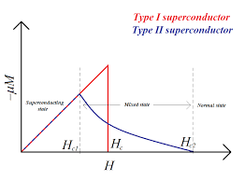
How do we probe quantum matter?
Macroscopic Probes
Electrical Transport
Magnetometry

Slide 11
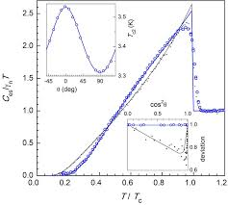
How do we probe quantum matter?
Macroscopic Probes
Electrical Transport
Magnetometry
Calorimetry

Slide 12
How do we probe quantum matter?
Macroscopic Probes
Electrical Transport
Magnetometry
Calorimetry
These measurements reveal that something unusual occurs...

Slide 13
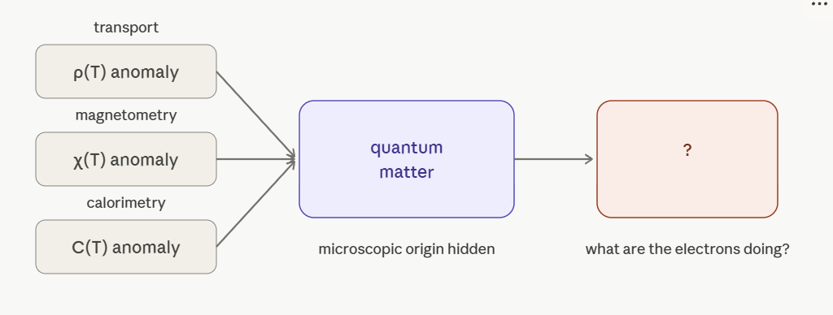
… but they do not tell us directly what the electrons are doing

Slide 14
What do we really want to know?

Slide 15
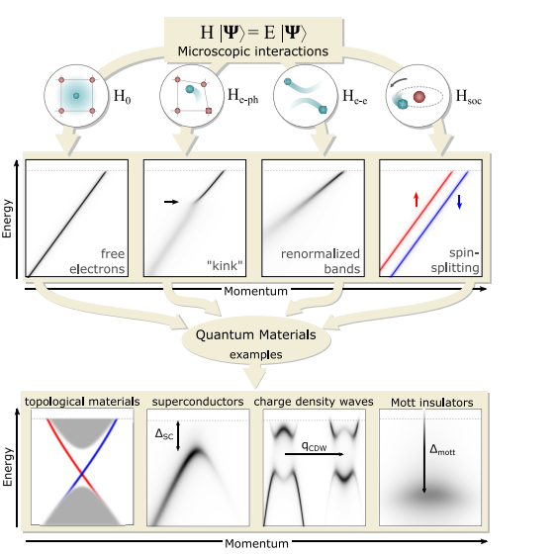
What do we really want to know?
What states exist?

Slide 16
What do we really want to know?
What states exist?
Which are occupied?

Slide 17
What do we really want to know?
What states exist?
Which are occupied?
How do interactions
modify them?

Slide 18
What do we really want to know?
What states exist?
Which are occupied?
How do interactions
modify them?
How do they disperse?

Slide 19
What do we really want to know?
What states exist?
Which are occupied?
How do interactions
modify them?
How do they disperse?
How long do they live?

Slide 20
What do we really want to know?
Can we directly observe the electronic degrees of freedom?

Slide 21

The Spectral Function
$$A\left(k,ω\right)=−\frac{1}{π}Im G^{R}(k,ω)$$
The central quantity describing electronic excitations.
Notes:
It tells us:
Energy
Momentum
Lifetime
Spectral weight
If we could measure $A\left(k , ω\right)$, we could directly observe many-body physics.

Slide 22
The Spectral Function
$$A\left(k,ω\right)=−\frac{1}{π}Im G^{R}(k,ω)$$
The central quantity describing electronic excitations.
Encodes:
Where electronic states exist
Their momentum
Their lifetime
Their spectral weight
Notes:
It tells us:
Energy
Momentum
Lifetime
Spectral weight
If we could measure $A\left(k , ω\right)$, we could directly observe many-body physics.

Slide 23

The Spectral Function
$$A\left(k,ω\right)=−\frac{1}{π}Im G^{R}(k,ω)$$
The central quantity describing electronic excitations.
Encodes:
Where electronic states exist
Their momentum
Their lifetime
Their spectral weight
If we could measure$A\left(k,ω\right)$, we could directly observe many-body physics.
Notes:
It tells us:
Energy
Momentum
Lifetime
Spectral weight
If we could measure $A\left(k , ω\right)$, we could directly observe many-body physics.

Slide 24
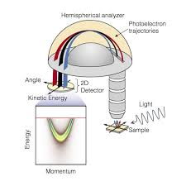
Section 2: The ARPES Experiment
Notes:
It tells us:
Energy
Momentum
Lifetime
Spectral weight
If we could measure $A\left(k , ω\right)$, we could directly observe many-body physics.

Slide 25
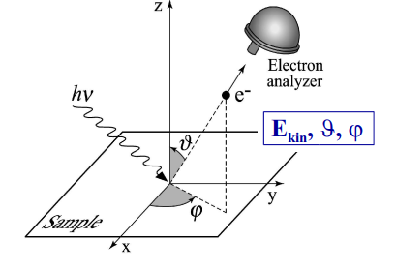
ARPES: General Description
ARPES exploits the kinematics of the photoemission process to:

Slide 26

ARPES: General Description
ARPES exploits the kinematics of the photoemission process to:
deduce the binding energy $E_{B}$

Slide 27

ARPES: General Description
ARPES exploits the kinematics of the photoemission process to:
deduce the binding energy $E_{B}$
crystal momentum $ℏk$
of the electron before it was emitted from the material

Slide 28

ARPES: Experimental Process
Irradiate a single-crystal sample with monochromatic light of energy $hν$

Slide 29

ARPES: Experimental Process
Irradiate a single-crystal sample with monochromatic light of energy $hν$
Collect photoelectrons in spectrometer

Slide 30

ARPES: Experimental Process
Irradiate a single-crystal sample with monochromatic light of energy $hν$
Collect photoelectrons in spectrometer
Record the kinetic energy $E_{kin}$ and emission angles $(θ,φ)$

Slide 31
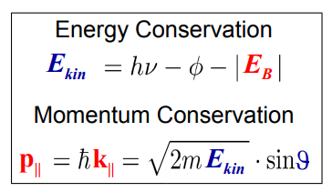
ARPES: Conservation Laws
Notes:
In-plane momentum is conserved throughout the photoemission process due to in-plane periodicity modulo an inplane reciprocal lattice vector… the orthogonal component is not conserved

Slide 32
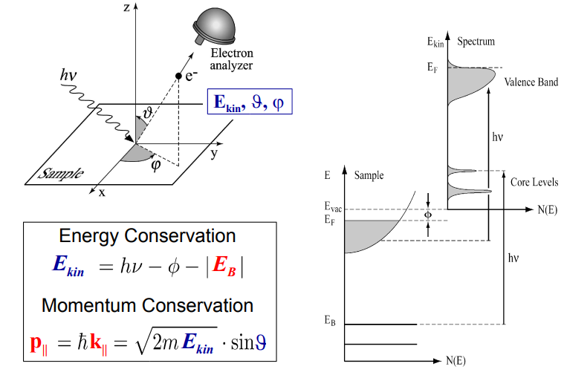
ARPES: Conservation of Energy

Slide 33
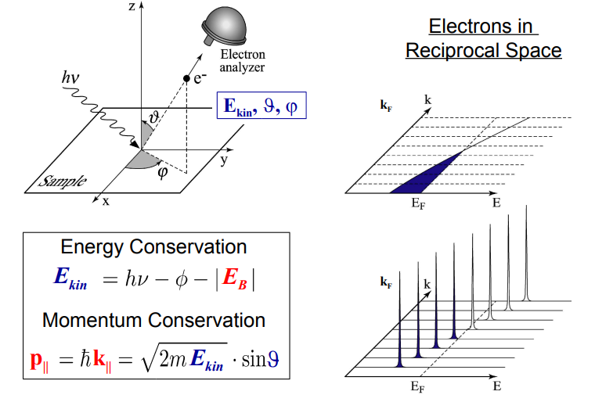
ARPES: Momentum Conservation

Slide 34
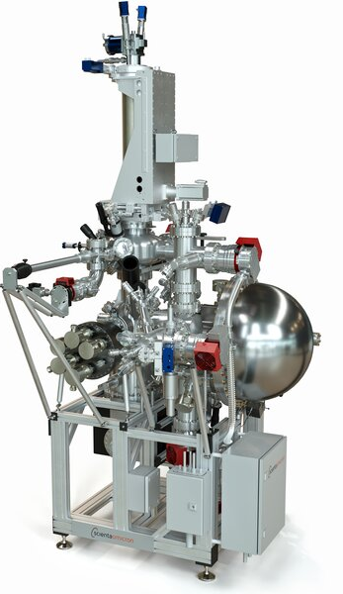
ARPES: Experimental Setup
Performed in ultra high-vacuum environments (<10⁻¹⁰ mbar)
At cryogenic temperatures (<15 K)
Multi-axis manipulator
Detectors are hemispherical analyzers
Can use a range of light sources such as:
Lasers (6 – 11 eV)
Plasma sources (21-40 eV)
VUV synchrotrons (20-200 eV)
Soft- Xray synchrotrons (400-1000 eV)

Slide 35
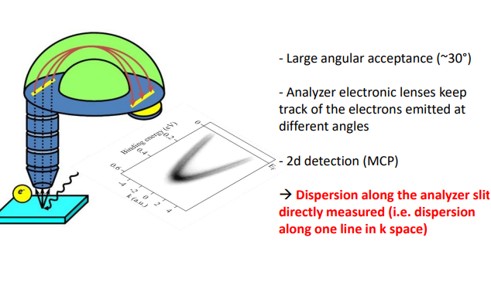
ARPES: ARPES Measurements
2d dispersions

Slide 36
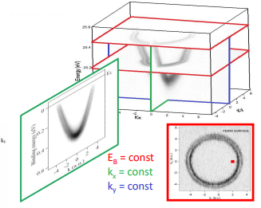
ARPES: ARPES Measurements
2d dispersions
3d maps

Slide 37
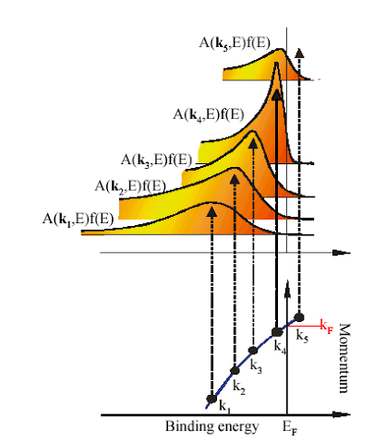
Section 3: ARPES Formalism
Notes:
It tells us:
Energy
Momentum
Lifetime
Spectral weight
If we could measure $A\left(k , ω\right)$, we could directly observe many-body physics.

Slide 38
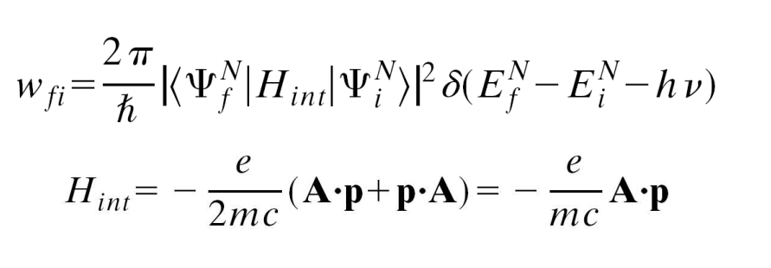
ARPES: Fermi’s Golden Rule

Slide 39

ARPES: Fermi’s Golden Rule
Formally:
Photoemission process described by transition probability $w_{fi}$
N-electron initial state $|Ψ_{i}^{N}>$ to an excited final state $|Ψ_{f}^{N}>$

Slide 40

ARPES: Fermi’s Golden Rule
Formally:
Photoemission process described by transition probability $w_{fi}$
N-electron initial state $|Ψ_{i}^{N}>$ to an excited final state $|Ψ_{f}^{N}>$
$H_{int}$ is a perturbative Hamiltonian describing the electron-photon interaction

Slide 41
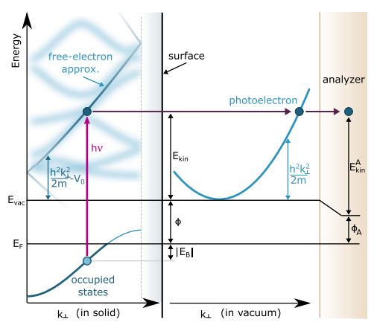
ARPES: Three-step model

Slide 42
ARPES: Three-step model
Photon drives a direct optical transition for an electron in the bulk of the material. This step contains the information on the intrinsic electronic structure of the material.

Slide 43
ARPES: Three-step model
Photon drives a direct optical transition for an electron in the bulk of the material. This step contains the information on the intrinsic electronic structure of the material.
Electron propagates to the surface. This process is described in terms of an effective mean free path λ_{MFP} imposed by both elastic and inelastic scattering processes.

Slide 44
ARPES: Three-step model
Photon drives a direct optical transition for an electron in the bulk of the material. This step contains the information on the intrinsic electronic structure of the material.
Electron propagates to the surface. This process is described in terms of an effective mean free path λ_{MFP} imposed by both elastic and inelastic scattering processes.
Electron is transmitted through the surface barrier, with the electron occupying a free-electron plane wave state in the vacuum extending to the detector.

Slide 45
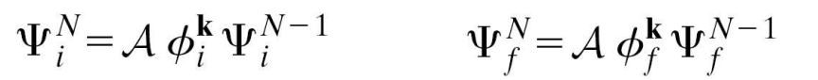

ARPES: Three-step model (step 1)
Consider a non-interacting system:
Invoke the Sudden approximation
The N-electron initial and final states are given by
Where A is an anti-symmetry operator enforcing the Pauli principle
$\left.|φ_{i}^{k}\right\rangle$ and$\left.|φ_{f}^{k}\right\rangle$ are wave function of the electron before and after absorbing a photon
Both have same wave vector k due to momentum conservation
They have energies $ε_{k}$ and $ε_{f}$
The non-interacting limit says that the (N-1) system is unaffected by the removal of one electron --- thus $Ψ_{i}^{N−1 }$ is equal to $Ψ_{f}^{N−1 }$

Slide 46


ARPES: Non-interacting photocurrent
If we calculate the total photocurrent:
$$I=\sum_{i,f}{w_{fi}}$$
Plugging approximations into:
Assuming a single transition (i->f) at each k
We recover:

Slide 47
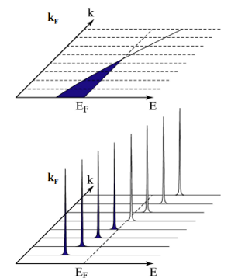
ARPES: Non-interacting photocurrent
ARPES spectrum of a noninteracting system is:
- a sharp peak that traces the electronic band dispersion ϵ_{k}
- with its intensity modulated by the dipole matrix element.
This result establishes the capability of ARPES to be used as a band-mapping technique

Slide 48
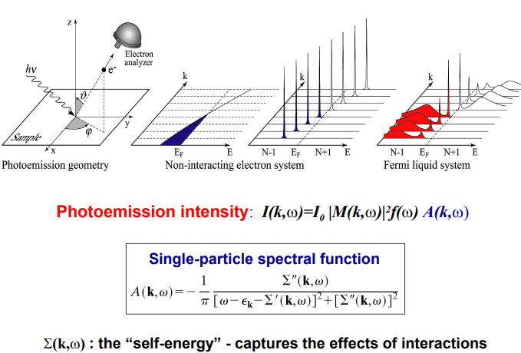
ARPES: Single-particle spectral function

Slide 49
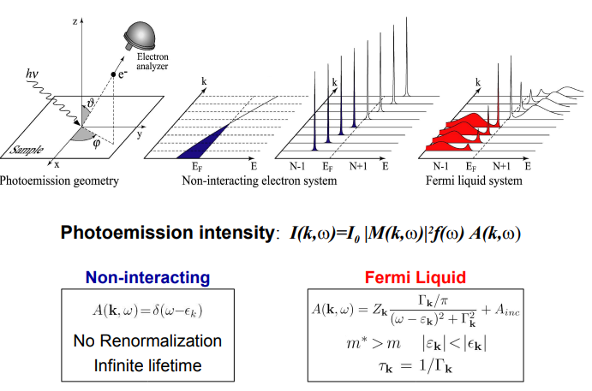

ARPES: Single-particle spectral function
$$Z_{k}={\left(1−\frac{∂Σ^{′}}{∂ω}\right)}^{−1}$$
$$ε_{k}=Z_{k}(ε_{k}+Σ^{′})$$
$$Γ_{k}=Z_{k}\left|Σ^{′′}\right|$$
Description valid near the
Fermi surface with the
conditions $\left|Σ^{′′}\right|≪ε_{k}$ for
small $ω$ .

Slide 50
ARPES: Single-particle spectral function
This is what elevates ARPES from being a band-structure camera to a many-body spectroscopy

Slide 51
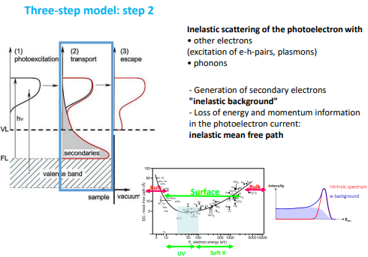
ARPES: Three-step model (step 2)

Slide 52
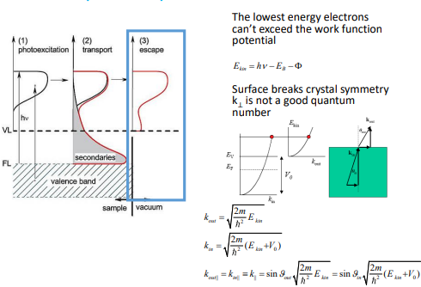
ARPES: Three-step model (step 3)

Slide 53
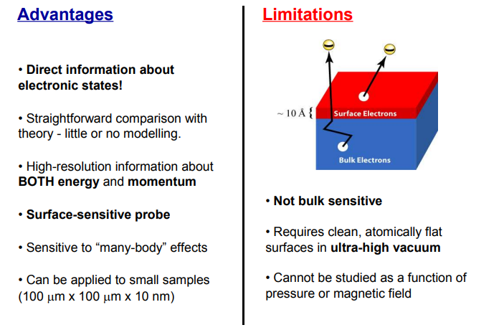
ARPES: Advantages and Limitations

Slide 54
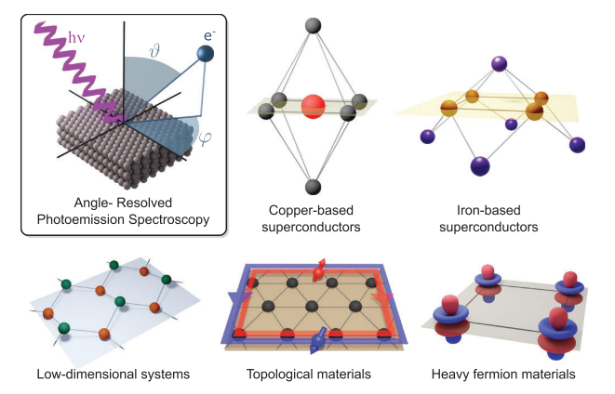
Section 4: Real Examples
Notes:
It tells us:
Energy
Momentum
Lifetime
Spectral weight
If we could measure $A\left(k , ω\right)$, we could directly observe many-body physics.

Slide 55
Class: Topological Materials
ARPES is ideally suited for studying 2-dimensional materials

Slide 56
Class: Topological Materials
ARPES is ideally suited for studying 2-dimensional materials
The interest in low-dimensional topological materials
in the 2010s came at a perfect time for ARPES

Slide 57
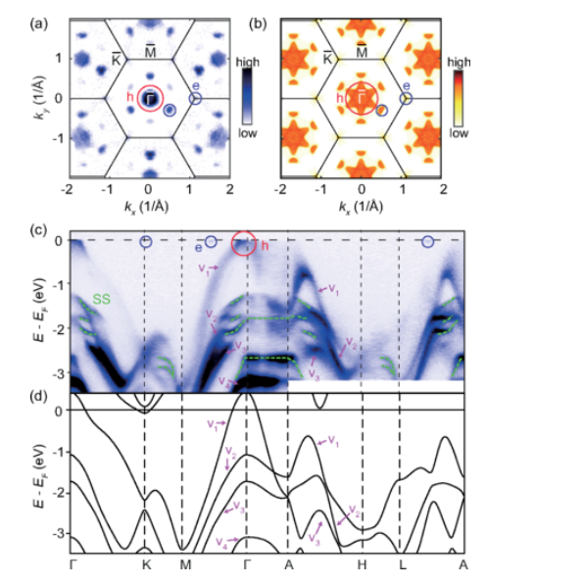
Class: Topological Materials
ARPES is ideally suited for studying 2-dimensional materials
The interest in low-dimensional topological materials
in the 2010s came at a perfect time for ARPES
Type-II Dirac Semimetal PtSe₂

Slide 58
Class: Topological Materials
ARPES is ideally suited for studying 2-dimensional materials
The interest in low-dimensional topological materials
in the 2010s came at a perfect time for ARPES
Type-II Dirac Semimetal PtSe₂
In some ways one can think of this close
the non-interacting limit and why vanilla DFT
does so well

Slide 59
Class: Correlated Transition Metal Oxides
Layered Ruddlesden-Popper Sr₂RuO₄ presents:
-highly-anisotropic transport behavior
-enhanced effective masses

Slide 60
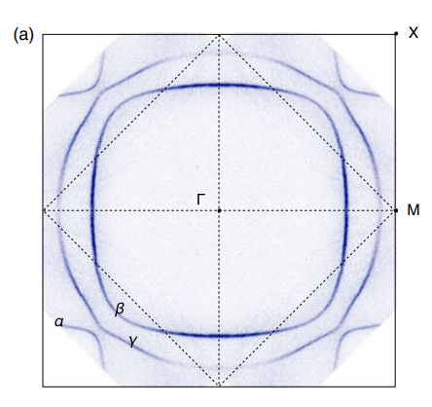
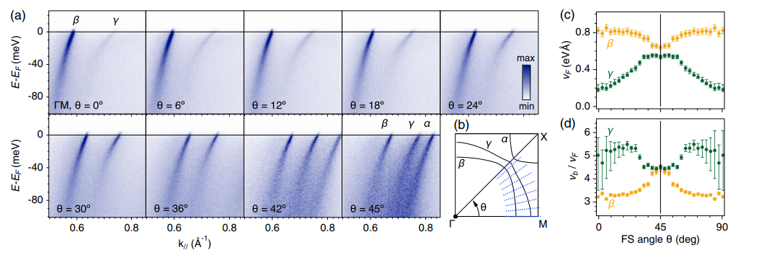
Class: Correlated Transition Metal Oxides
Layered Ruddlesden-Popper Sr₂RuO₄ presents:
-highly-anisotropic transport behavior
-enhanced effective masses

Slide 61
Class: Correlated Transition Metal Oxides
Layered Ruddlesden-Popper Sr₂RuO₄ presents:
-highly-anisotropic transport behavior
-enhanced effective masses
Highly 2d Fermi surface
Kinks in dispersions and reduced Fermi velocities showing
correlation effects

Slide 62
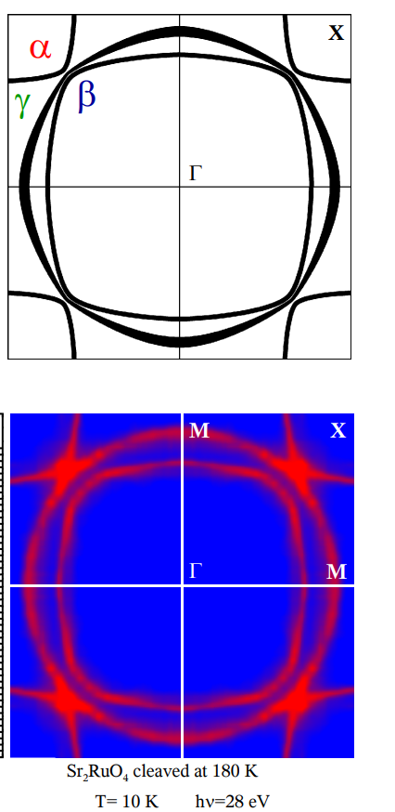
Class: Correlated Transition Metal Oxides
Fermi surface can be recovered by LDA calculations…

Slide 63
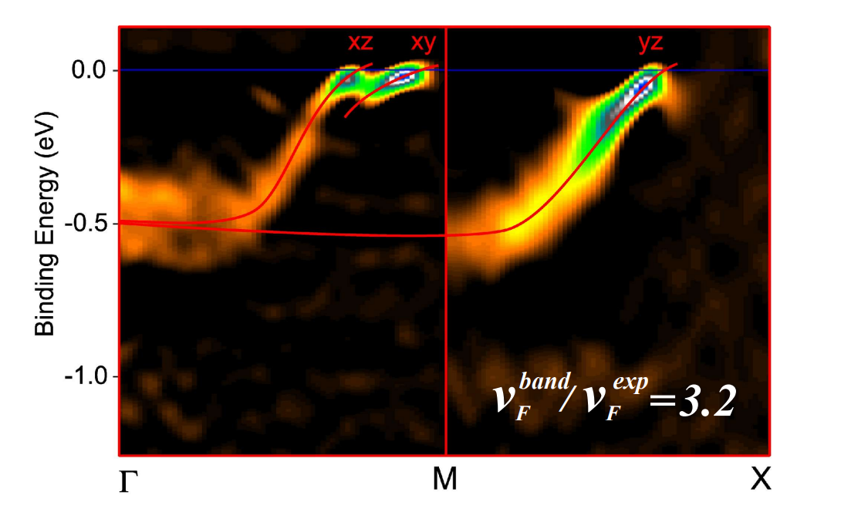
Class: Correlated Transition Metal Oxides
Fermi surface can be recovered by LDA calculations…
We need LDA+U to recover the renormalization of the
bands

Slide 64
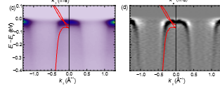
Class: Heavy Fermion Compounds
Formation of heavy bands in CePd₃ cannot be described by DFT

Slide 65
Class: Heavy Fermion Compounds
Formation of heavy bands in CePd₃ cannot be described by DFT
Reproducing the shift in spectral weight due to the
coherent Kondo lattice formation requires higher
level theory such as DMFT

Slide 66
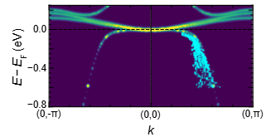
Class: Heavy Fermion Compounds
Formation of heavy bands in CePd₃ cannot be described by DFT
Reproducing the shift in spectral weight due to the
coherent Kondo lattice formation requires higher
level theory such as DMFT

Slide 67
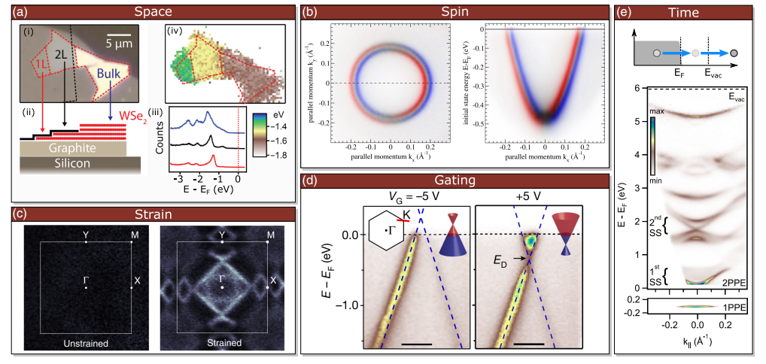
Section 5: Technological Advances
Notes:
It tells us:
Energy
Momentum
Lifetime
Spectral weight
If we could measure $A\left(k , ω\right)$, we could directly observe many-body physics.

Slide 68
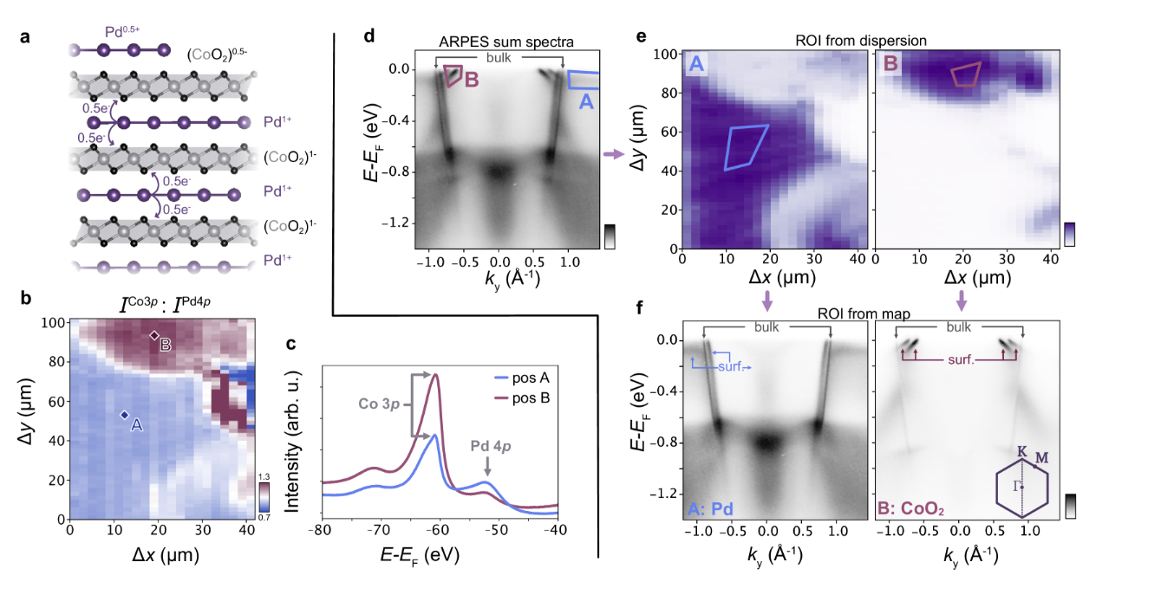
Advancement: Spatially-resolved ARPES
Development of spot-sizes below 10 microns allows for samples to be spatially profiled
We can now study heterostructure stacks as well as disparate terminations on cleaved samples
Delafossite
PdCoO₂

Slide 69
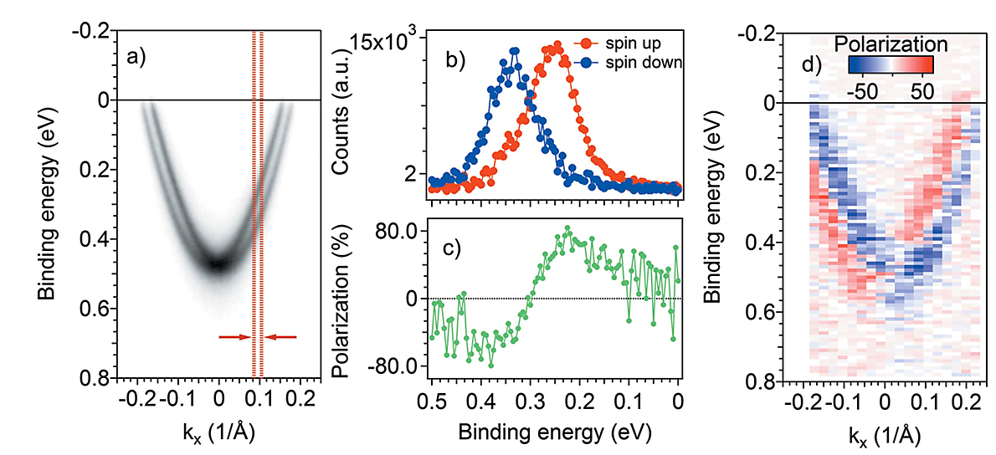
Advancement: Spin-resolved ARPES
Spin-resolved ARPES allows us to directly visualize momentum-locked spin textures in a range
of material classes
Rashba-split surface
state in Au(111)

Slide 70
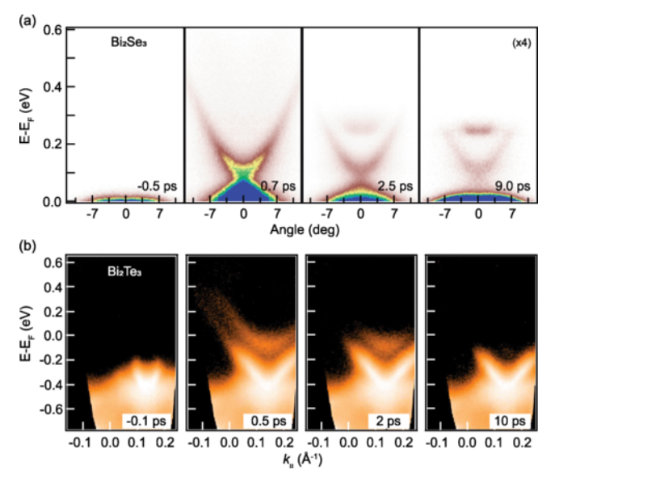
Advancement: Time-resolved ARPES
Time-resolved (tr)-ARPES allows one to characterize the nonequilibrium properties of quantum materials
Pump-probe technique
Can allow one to probe the dynamics for a range of quantum materials

Slide 71
Conclusions

Slide 72

Conclusions
ARPES provides direct access to electronic excitations
$$I\left(k , ω\right)∝∣M_{fi}∣^{2}f\left(ω\right)A\left(k , ω\right)$$
By measuring energy and momentum simultaneously, ARPES experimentally accesses the occupied spectral function.

Slide 73
Conclusions
ARPES provides direct access to electronic excitations
$$I\left(k , ω\right)∝∣M_{fi}∣^{2}f\left(ω\right)A\left(k , ω\right)$$
By measuring energy and momentum simultaneously, ARPES experimentally accesses the occupied spectral function.
ARPES is not a band-structure camera
It is a many-body spectroscopy sensitive to:
Renormalization
Spectral-weight transfer
Quasiparticle lifetimes
Collective electronic behavior

Slide 74
Conclusions
ARPES provides direct access to electronic excitations
$$I\left(k , ω\right)∝∣M_{fi}∣^{2}f\left(ω\right)A\left(k , ω\right)$$
By measuring energy and momentum simultaneously, ARPES experimentally accesses the occupied spectral function.
ARPES is not a band-structure camera
It is a many-body spectroscopy sensitive to:
Renormalization
Spectral-weight transfer
Quasiparticle lifetimes
Collective electronic behavior
ARPES and modern electronic structure theory form a powerful feedback loop
DFT → DFT+? → DMFT ↔ ARPES
Together they provide a microscopic understanding of quantum materials.

Slide 75

Conclusions
ARPES provides direct access to electronic excitations
$$I\left(k , ω\right)∝∣M_{fi}∣^{2}f\left(ω\right)A\left(k , ω\right)$$
By measuring energy and momentum simultaneously, ARPES experimentally accesses the occupied spectral function.
ARPES is not a band-structure camera
It is a many-body spectroscopy sensitive to:
Renormalization
Spectral-weight transfer
Quasiparticle lifetimes
Collective electronic behavior
ARPES and modern electronic structure theory form a powerful feedback loop
DFT → DFT+? → DMFT ↔ ARPES
Together they provide a microscopic understanding of quantum materials.
You calculate $A\left(k , ω\right)$.
We measure $A\left(k , ω\right)$.

Slide 76
Good References
https://link.aps.org/accepted/10.1103/RevModPhys.93.025006
https://journals.aps.org/rmp/abstract/10.1103/RevModPhys.93.025006
https://iopscience.iop.org/article/10.1238/Physica.Topical.109a00061
https://journals.aps.org/rmp/abstract/10.1103/RevModPhys.96.015003
https://iopscience.iop.org/journal/2516-1075/page/ARPES-topological-materials

